Slide 1
GReTEL 4 DEMO
Jan Odijk
AnnCor Meeting, Utrecht
2019-04-24

Slide 2
Overview
GrETEL 4 History
GrETEL 4
GrETEL 4 Corpus Upload
Examples

Slide 3
GrETEL 4: History
GrETEL (1): KU Leuven
  Cooperation CLARIN-NL and CLARIN Flanders
GrETEL 2,3: extensions, improvements in other Flemish projects
Application for searching in a Dutch treebank or parsebank
  Parsebank = text corpus in which each sentence has been assigned an automatically generated syntactic structure
  Treebank = text corpus in which each sentence has been assigned a manually verified syntactic structure
  Syntactic structure is usually a tree (actually not)
Core feature: example based querying

Slide 4
GrETEL 4: History
Treebanks (Dutch only):
  LASSY-Small (1 m tokens, written language)
  CGN (1 m tokens, spoken language)
  (V3) SoNaR Parsebank (>500 m tokens)
V1: http://nederbooms.ccl.kuleuven.be/eng/gretel/
V2: http://gretel.ccl.kuleuven.be/gretel-2.0/
V3: http://gretel.ccl.kuleuven.be/gretel3/index.php

Slide 5
GrETEL 4
GrETEL 4: UU Utrecht
  In CLARIAH and UU-internal AnnCor project
New functionality:
  Upload a user’s own corpus incl. metadata (Dutch)
  Search in the user’s own automatically parsed corpus (parsebank)
  Analysis of search results combined with metadata
  Better support for Xpath Queries
  Improved advanced interface
V4 (alpha!) http://gretel.hum.uu.nl/gretel4/

Slide 6
GrETEL 4: Corpus Upload
Upload Corpus
  (PaQu) Plain text or CHILDES CHAT
  TEI and FoLiA
CHAT Utterances are cleaned and metadata extracted:
  knor knor [!= pigsound], ik heb honger ➔
  knor knor, ik heb honger
Multiple cleaning options

Slide 7
Examples
3Vs: structures with 3 verbs
  Infinitivus Pro Participio (IPP)
Participles:
  Green Order (gekocht heeft)
  Red Order (heeft gekocht)

Slide 8
BUT:
  Example (QBE generalisation): 3Vs: participles?

Slide 9
Thanks for your Attention!

Slide 10


Slide 11

IPP verbs
The fact that several authors disagree on the set of verbs that can occur as IPP indicates that an empirical investigation is necessary in order to identify the Dutch IPP verbs.(Augustinus 2015:14)
➔ searching in treebanks using GrETEL
The data do not contain any IPP verbs that are not listed in the literature on the topic, and due to data sparseness, not all verbs encountered in the literature occur as IPP in the treebank data. For those verbs, their IPP status was defined by means of Internet data, in order to construct a typology that is based on empirical data. (Augustinus 2015:171)

Slide 12
Mod P: heel v. zeer
Corpus / m tokens | heel mod P | zeer mod P
LASSY-Small | 0,0 | 2,7
CGN | 7,9 | 1,8
VanKampenJAC | 3,3 | 0,0
VanKampen LAUorSAR | 6,5 | 0,0
CHILDES Dutch | 5,8 | 1,6
Basilex | 1,7 | 0,3
Wikipedia | 0,3 | 1,9
Notes:
In op kinderen gerichte teksten (CHILDES, Basilex) komt heel mod P vaker voor dan zeer mod P hoewel heel mod P niet gegeneraliseerd wordt naar alle gevallen en zeer mod P wel.

Slide 13
Heel+ V/P
Example | Subcorpus | Country | Descr
ze DJFacteuR sjah DJFacteuR is heel van slag ocharme drm speelk ni graag online | WR-U-E-A-0000104018 | B | chats
- ) . Als ik heel per ongeluk in een andere auto rijd dan | WR-P-E-A-0000506410 | B | discussion lists
e midweekje naar oostrozebeke : heel van de kaart : lol : | WR-P-E-A-0000188664 | U | discussion lists
en Janez Detd trok me heel over de streep | WR-P-E-A-0000296105 | B | discussion lists
deze topic waar ge zo heel uit de hoogte doet omdat die persoon dubbelpostte | WR-P-E-A-0000463665 | U | discussion lists
ik bedoel gwn die t-shirts heel in het zwart snapte gwn mé het logotje … | WR-P-E-A-0000146523 | B | discussion lists
… zo iemand tegenkomen en tis heel in orde ; ) kuskes en succes … | WR-P-E-A-0000055681 | B | discussion lists
… ne camera is , ist heel in orde : ) … | WR-P-E-A-0000045331 | B | discussion lists
… of Futures jaimykeuh je ben heel op het slechte pad een brug oversteken : - | WR-P-E-A-0000188955 | B | discussion lists
… ouders die zich hiervoor interesseren heel op prijs . Bedankt , Fred … | WR-P-E-A-0004642784 | NL | discussion lists
… niet . Ik zou het heel op prijs stellen als de vraagsteller de … | WR-P-E-A-0005355195 | NL | discussion lists
… zitten nog niet of slechts heel ten dele in deze resultaten . Aan … | WR-P-P-G-0000448580 | B | newspaper text
… . En dat was ook heel ten onrechte, denk ik . Het … | WR-P-E-G-0000008944 | B | subtitles

Slide 14
Query Example
Constructions with 3 bare verbs in the Dutch CHILDES Van Kampen Laura Corpus
Example sentence:
  Hij zal dat willen doen

Slide 15
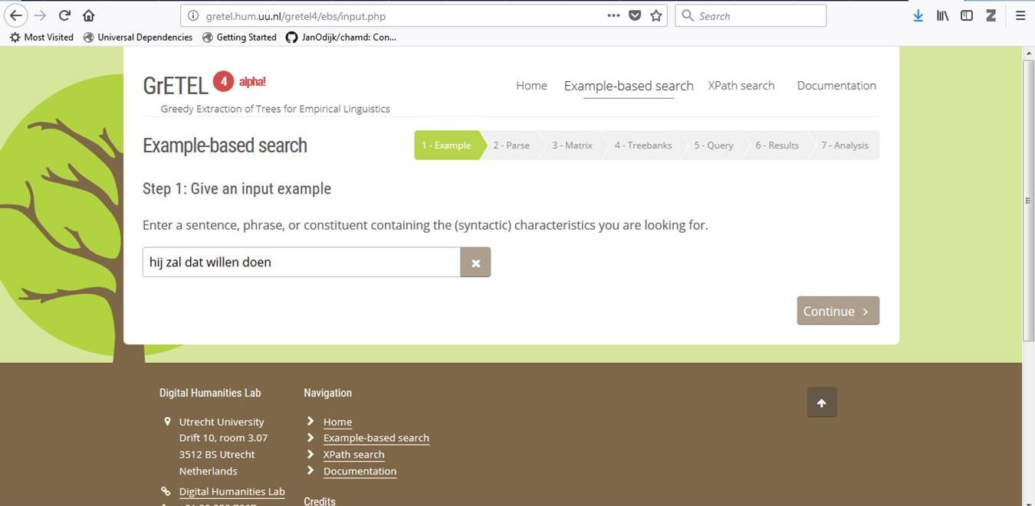
Example Sentence

Slide 16
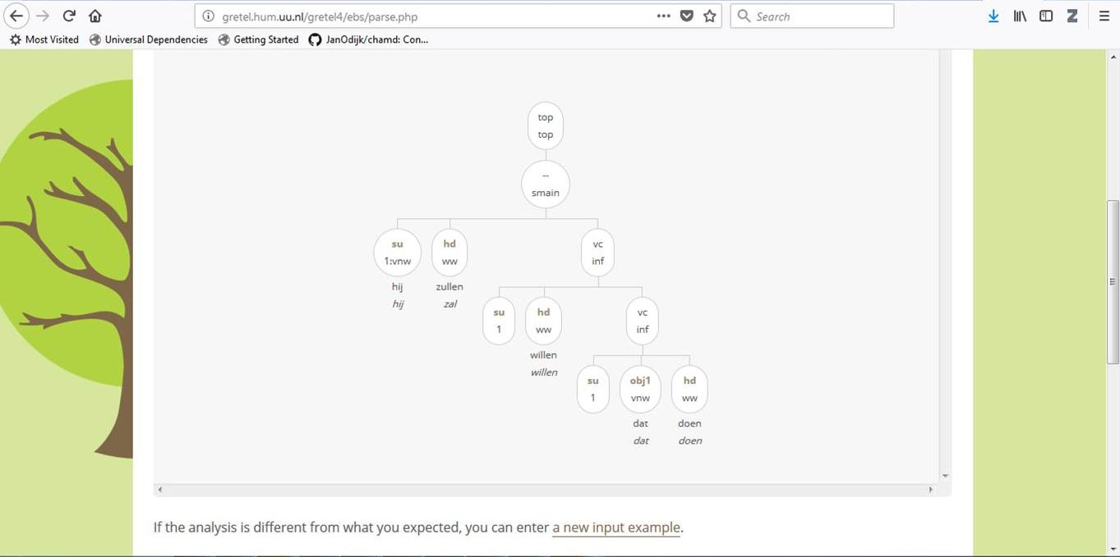
Parse Tree

Slide 17
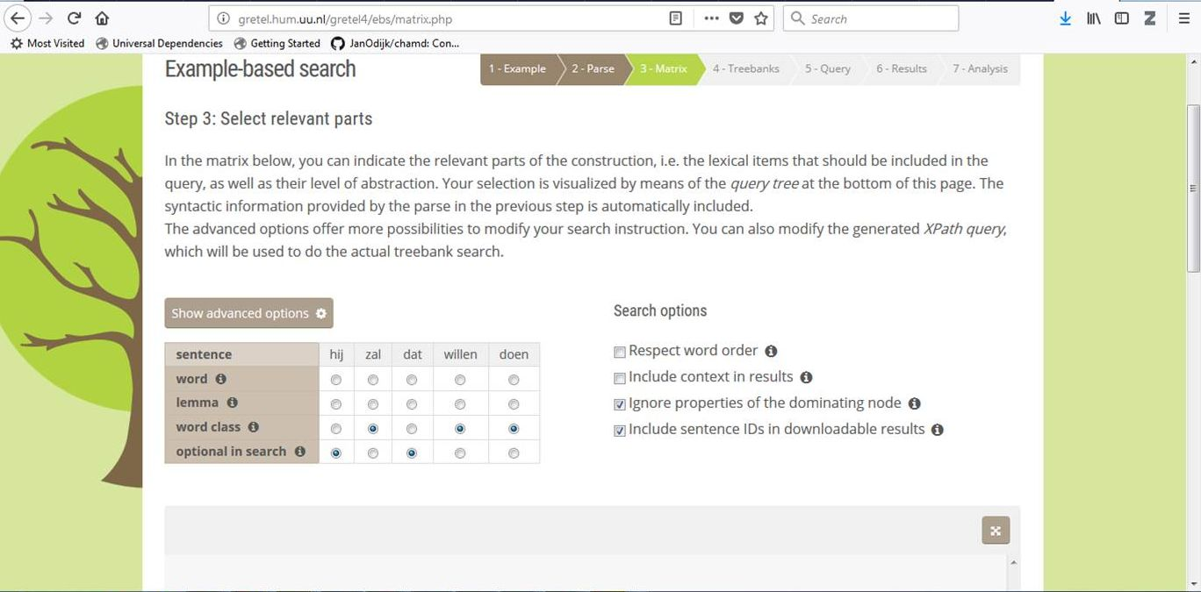
Select Parts

Slide 18
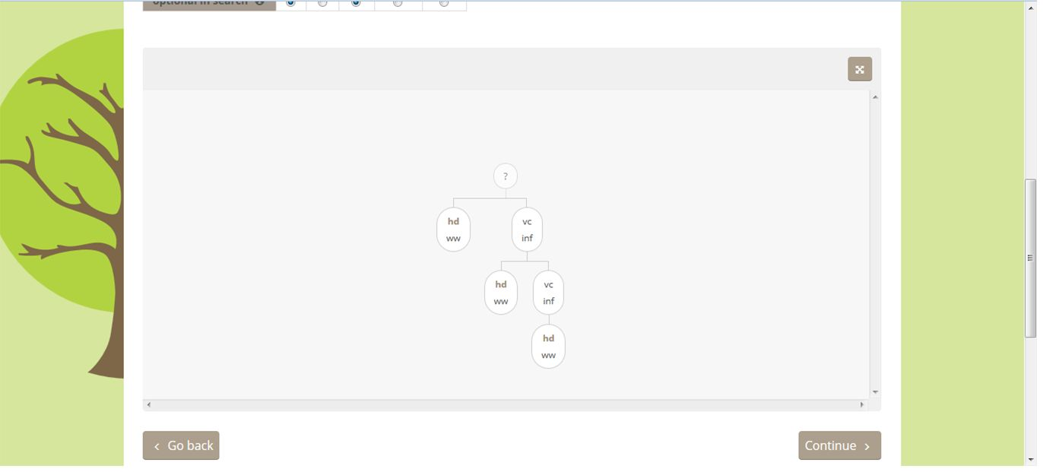
Query Tree

Slide 19
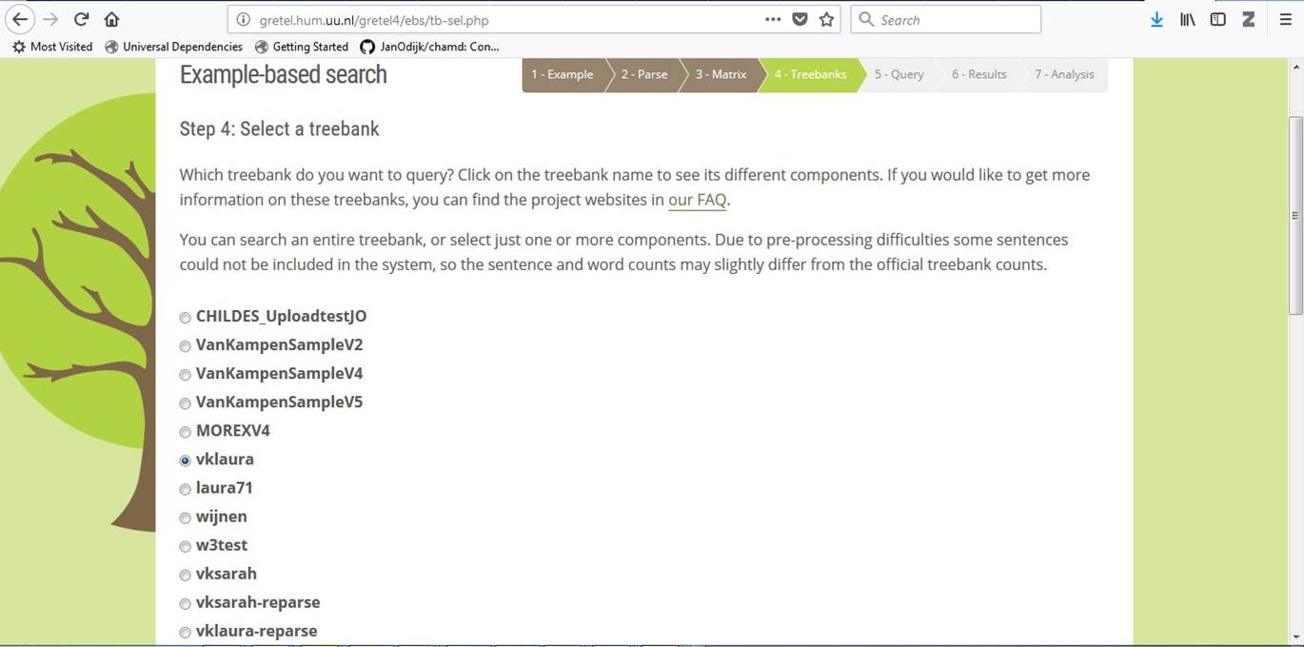
Select Treebank

Slide 20
Query
//node[@cat and
node[@pt="ww" and @rel="hd"] and node[@cat="inf" and @rel="vc" and node[@rel="hd" and @pt="ww"] and node[@rel="vc" and @cat="inf" and node[@pt="ww" and @rel="hd"]]]]

Slide 21
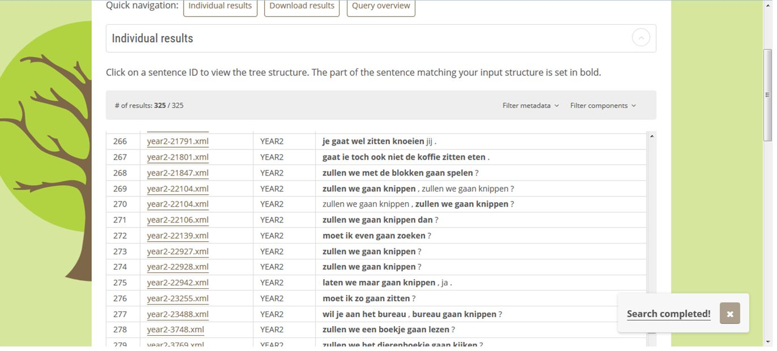
Example: Query Output

Slide 22
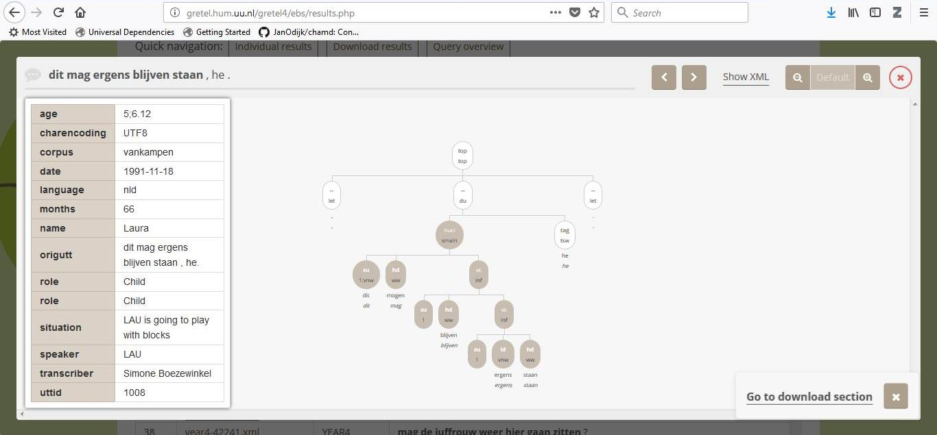
Utterance Details

Slide 23
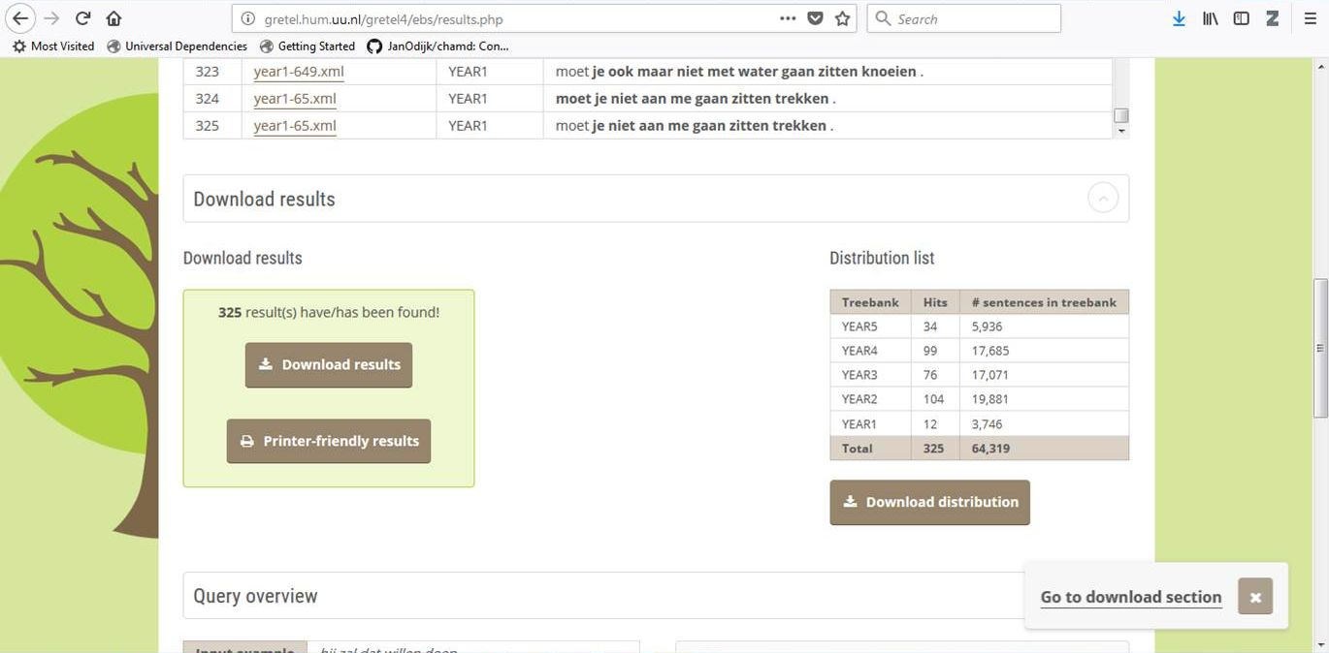
Result Statistics

Slide 24
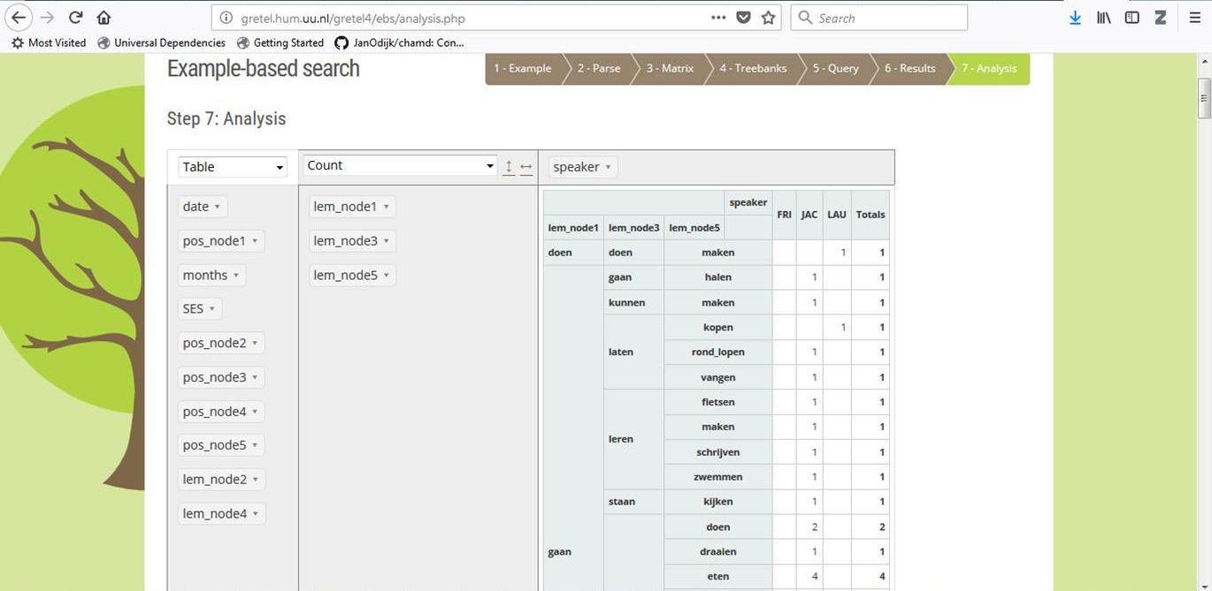
Analysis

Slide 25
Some Results
3 verbs:
  325 hits found
  313 by adults, 12 by target child (LAU)
  4 by child do not occur among adults
  8 others are not in most frequent of adults
  Child examples as of month 43 (3;7)

Slide 26
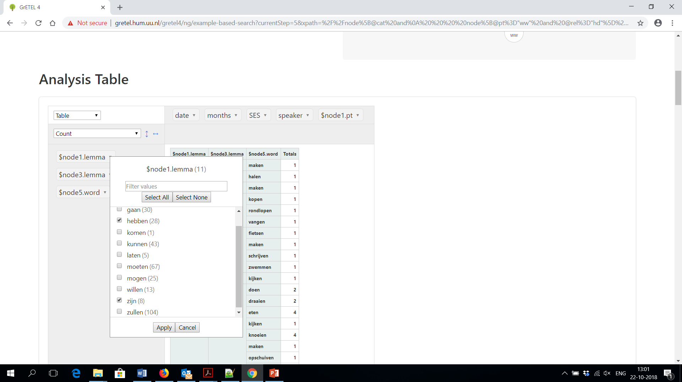
IPP

Slide 27
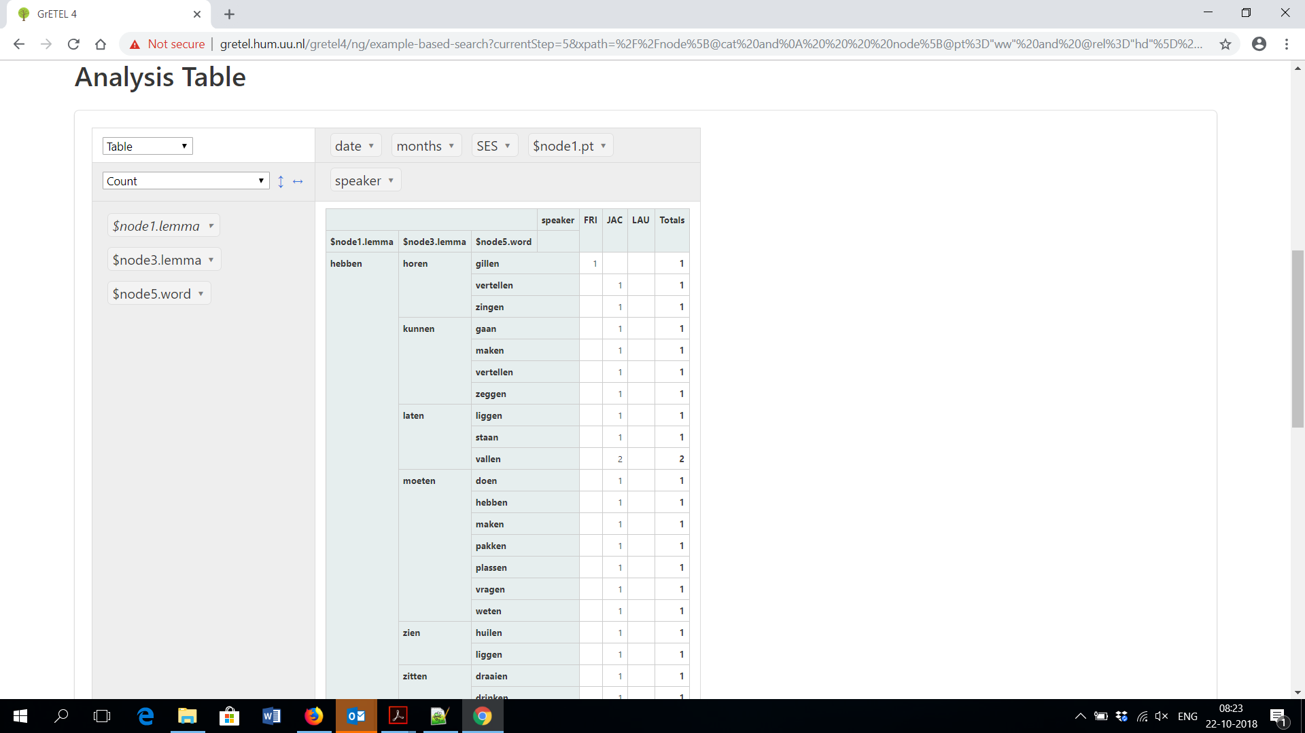
IPP

Slide 28
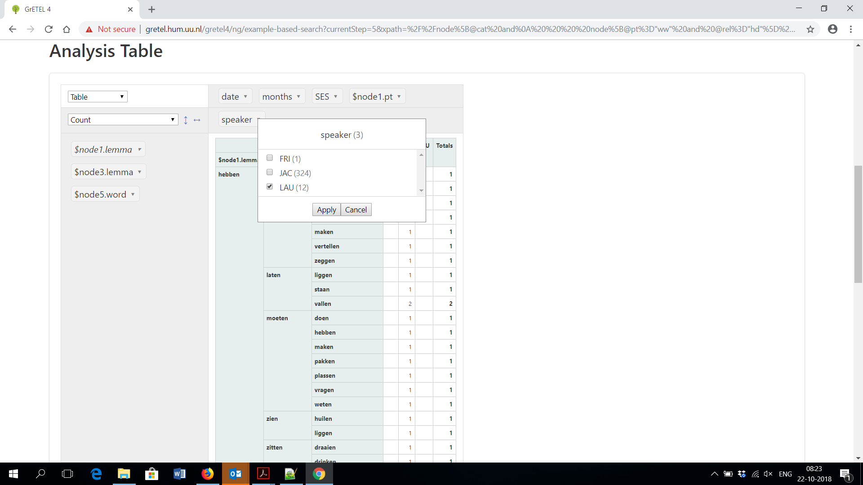
IPP

Slide 29
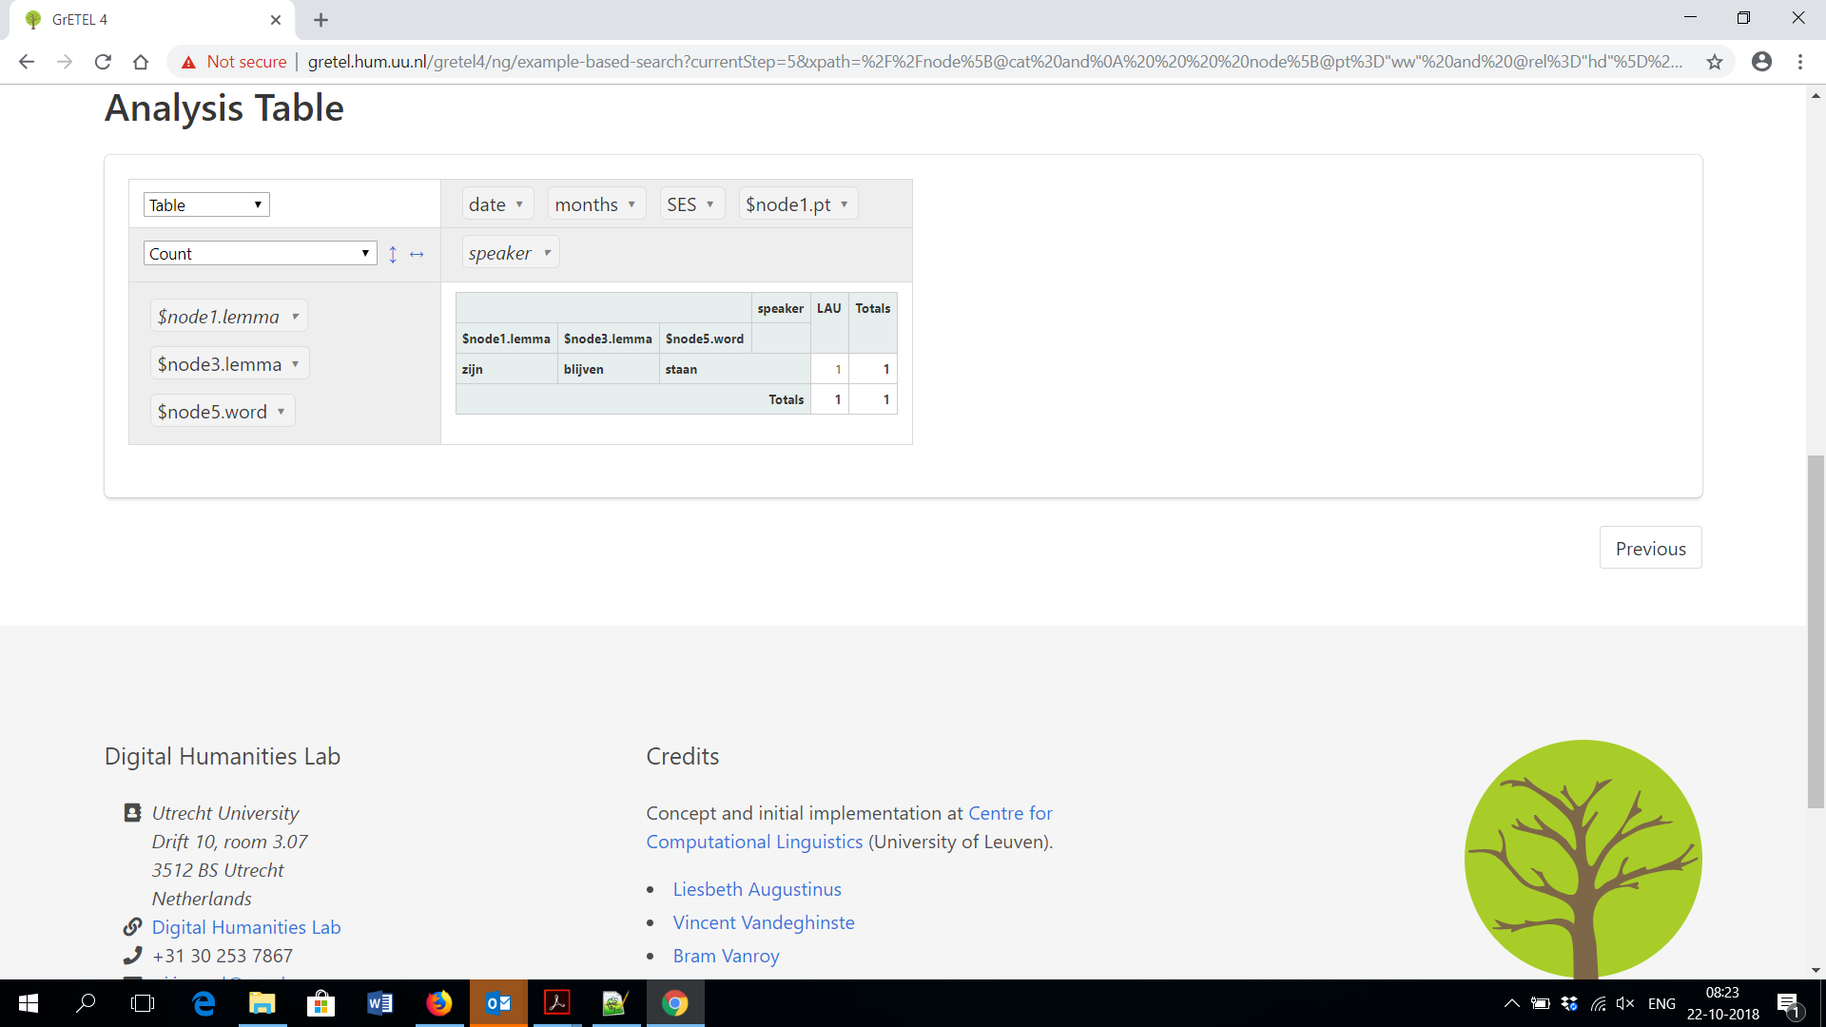
IPP

Slide 30

IPP
IPP= Infinitivus Pro Participio
Results:
  36 matches
    28 with hebben
    8 with zijn
  Speakers:
    JAC 34
    FRI 1
    LAU 1: zijn blijven staan

Slide 31
Participles?
//node[@cat and
node[@pt="ww" and @rel="hd"] and node[@cat="inf" and @rel="vc" and node[@rel="hd" and @pt="ww"] and node[@rel="vc" and @cat="inf" and node[@pt="ww" and @rel="hd"]]]]

Slide 32
Participles?
//node[@cat and
node[@pt="ww" and @rel="hd"] and node[@cat="inf" and @rel="vc" and node[@rel="hd" and @pt="ww"] and node[@rel="vc" and @cat="inf" and node[@pt="ww" and @rel="hd"]]]]

Slide 33
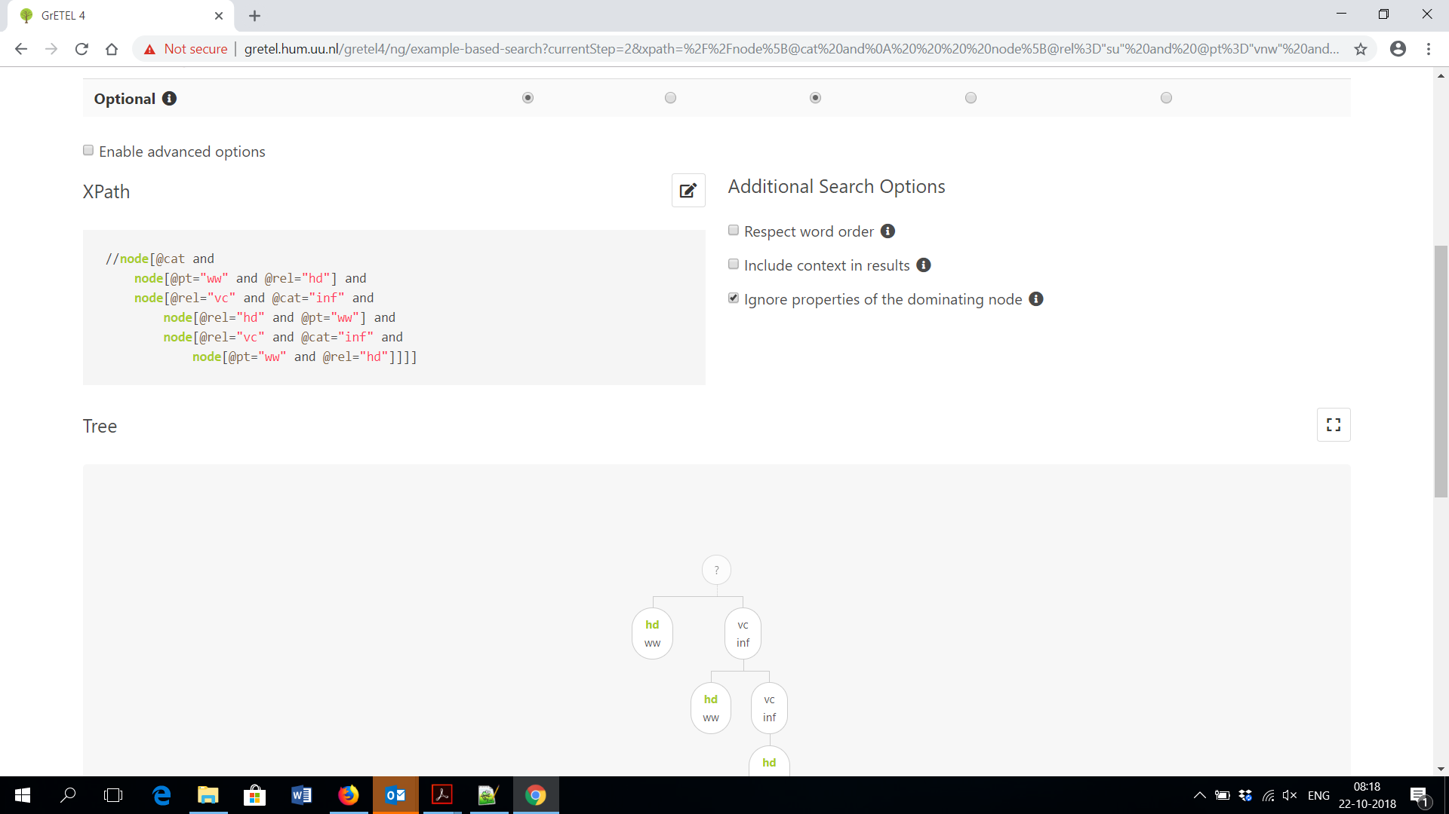
Participles?

Slide 34
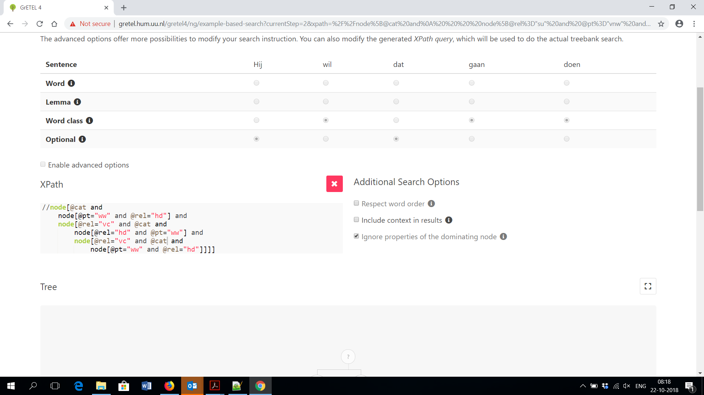
Participles?

Slide 35
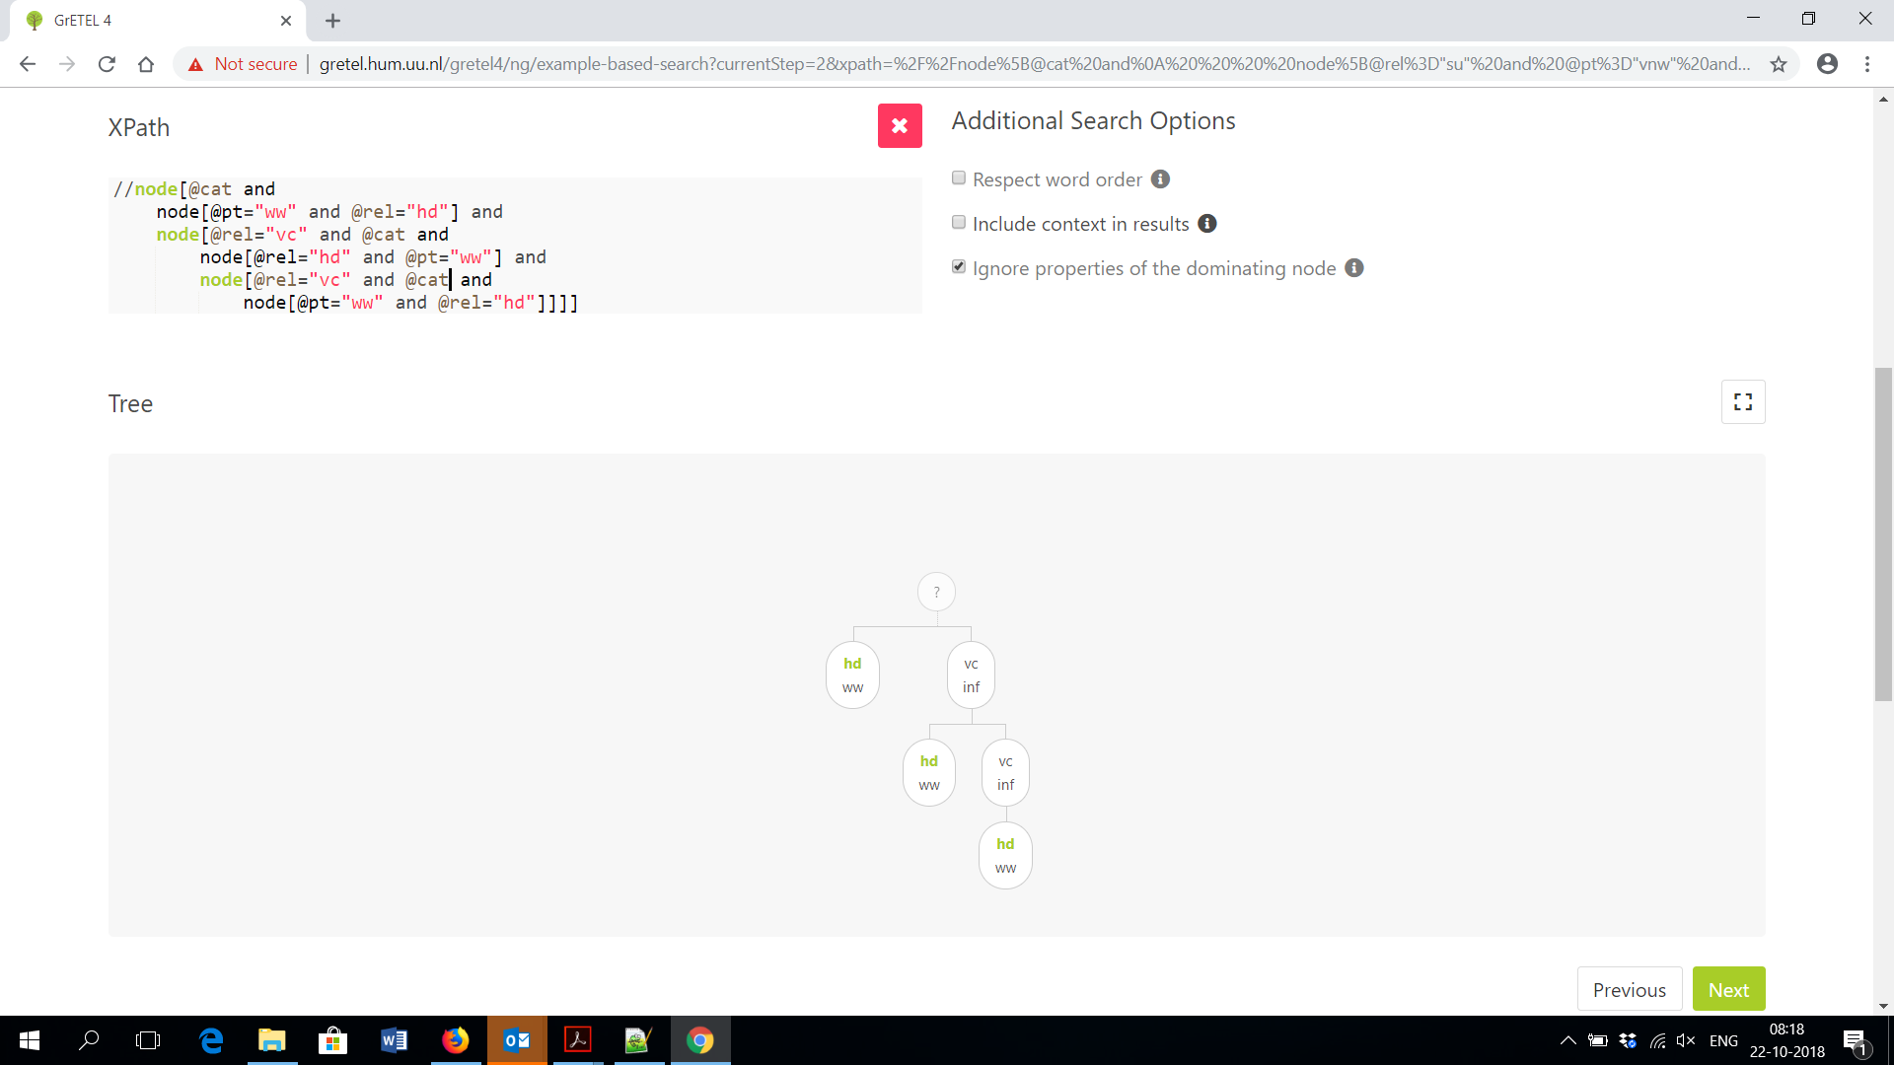
Participles?

Slide 36
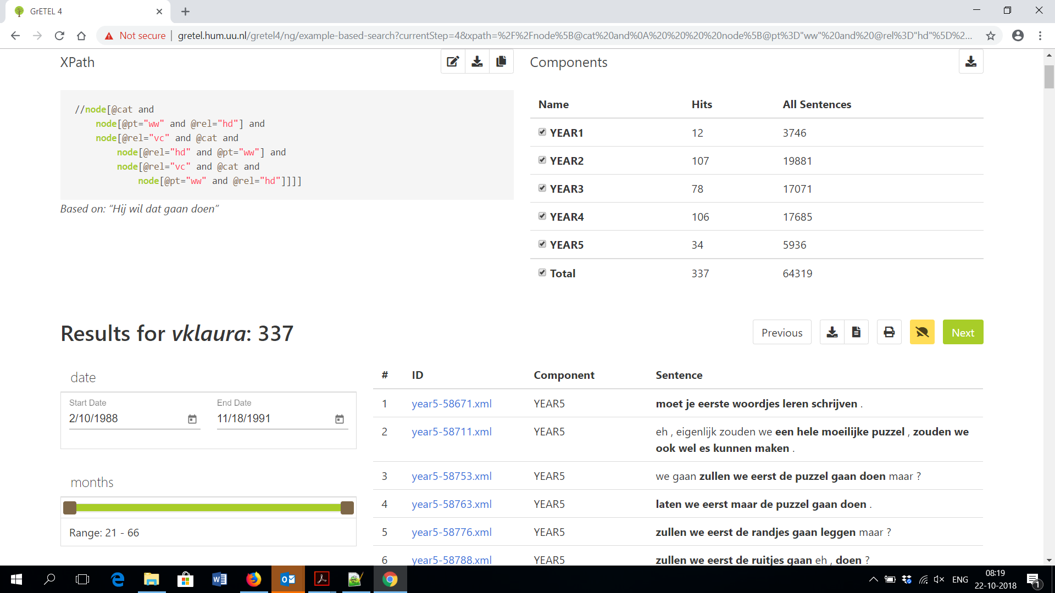
Participles?

Slide 37
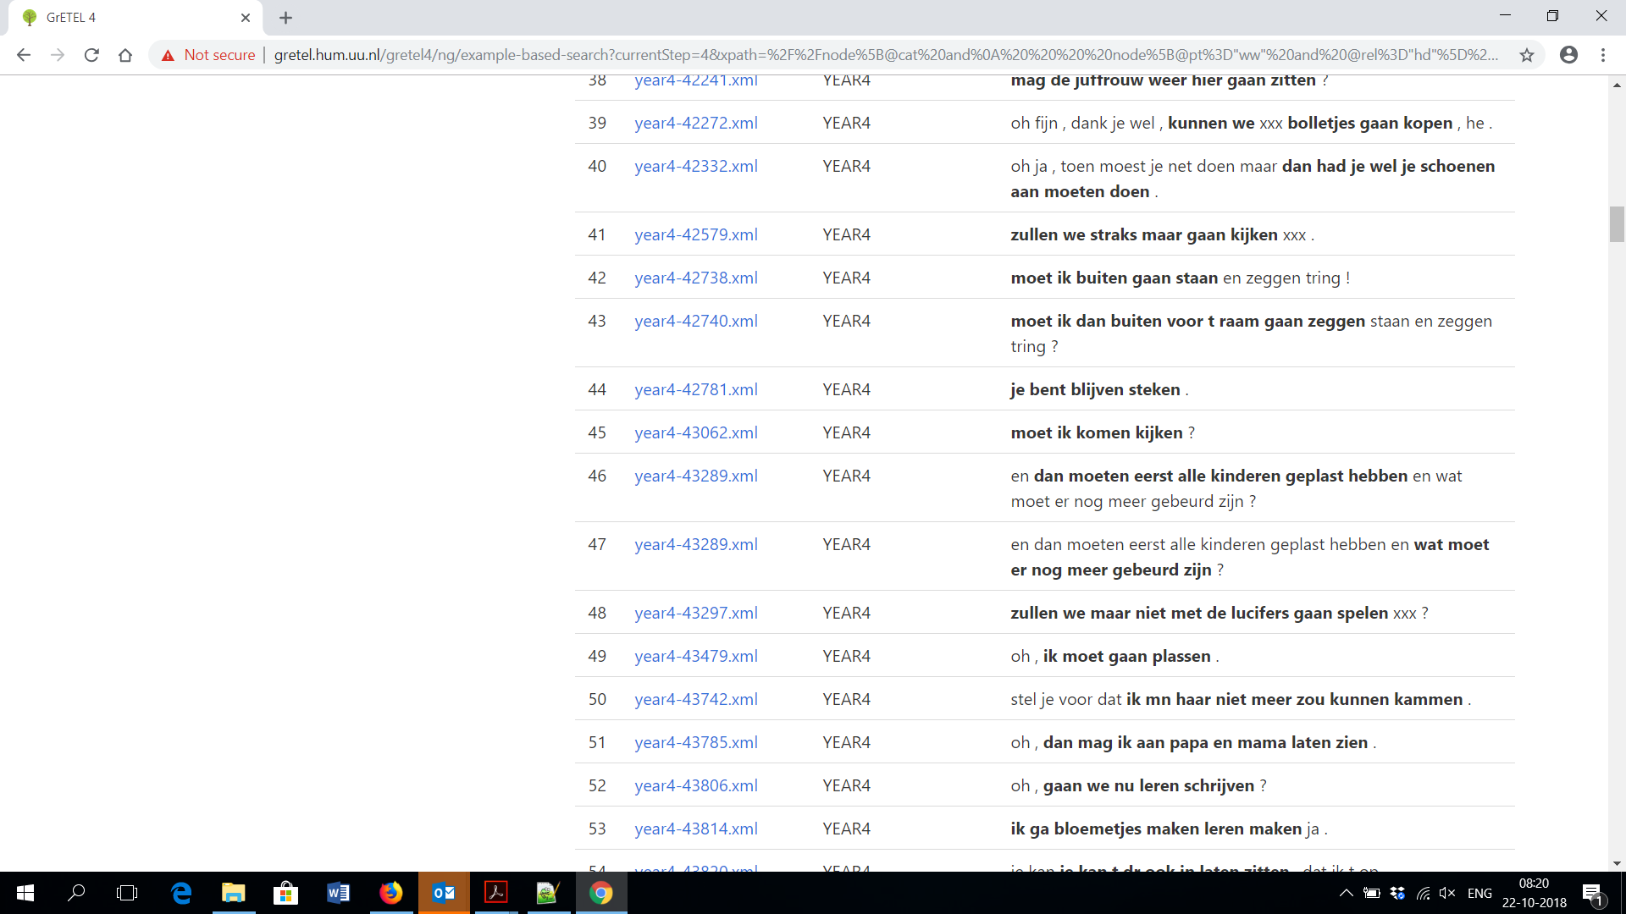
Participles?

Slide 38
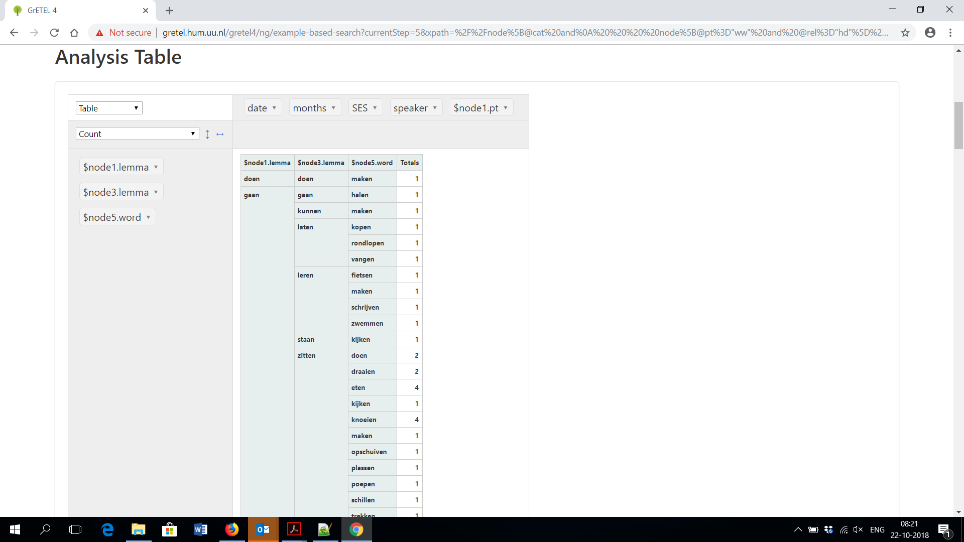
Participles?

Slide 39
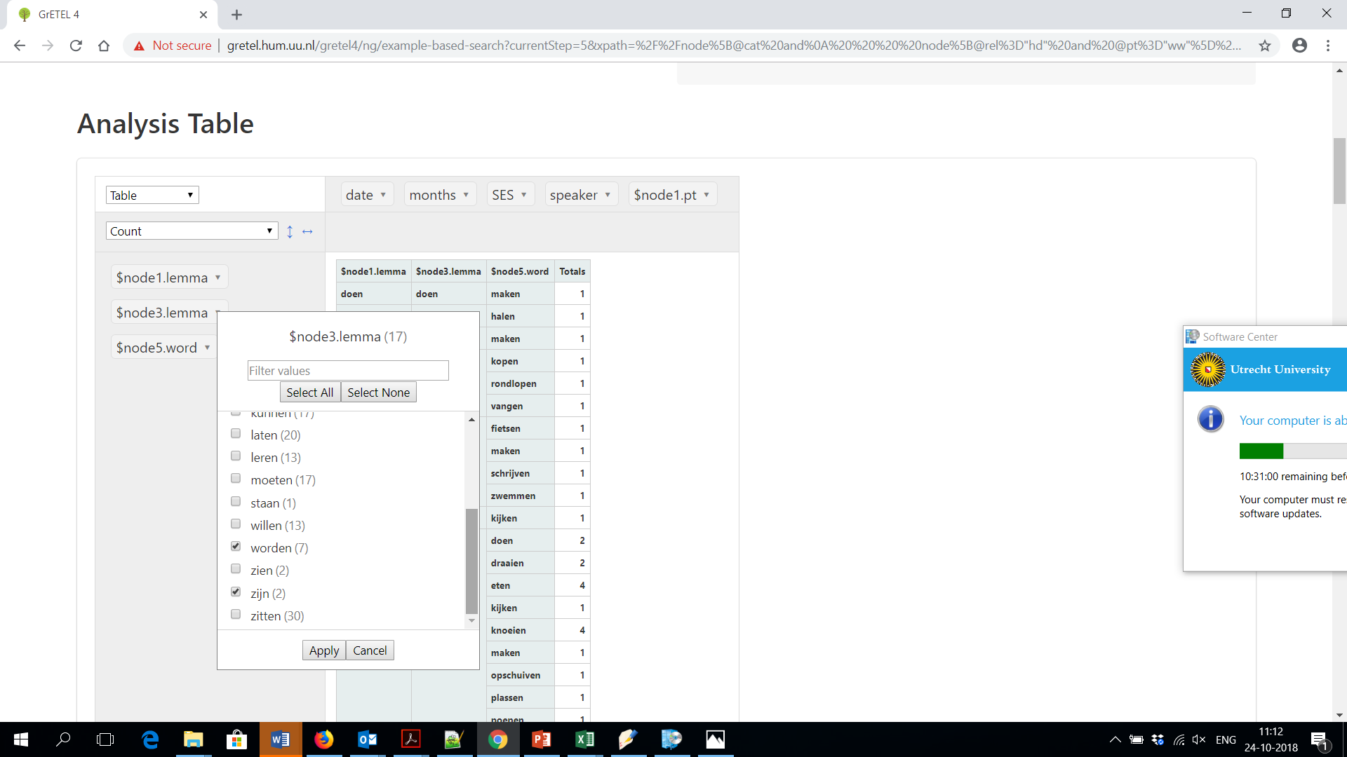
Participles?

Slide 40
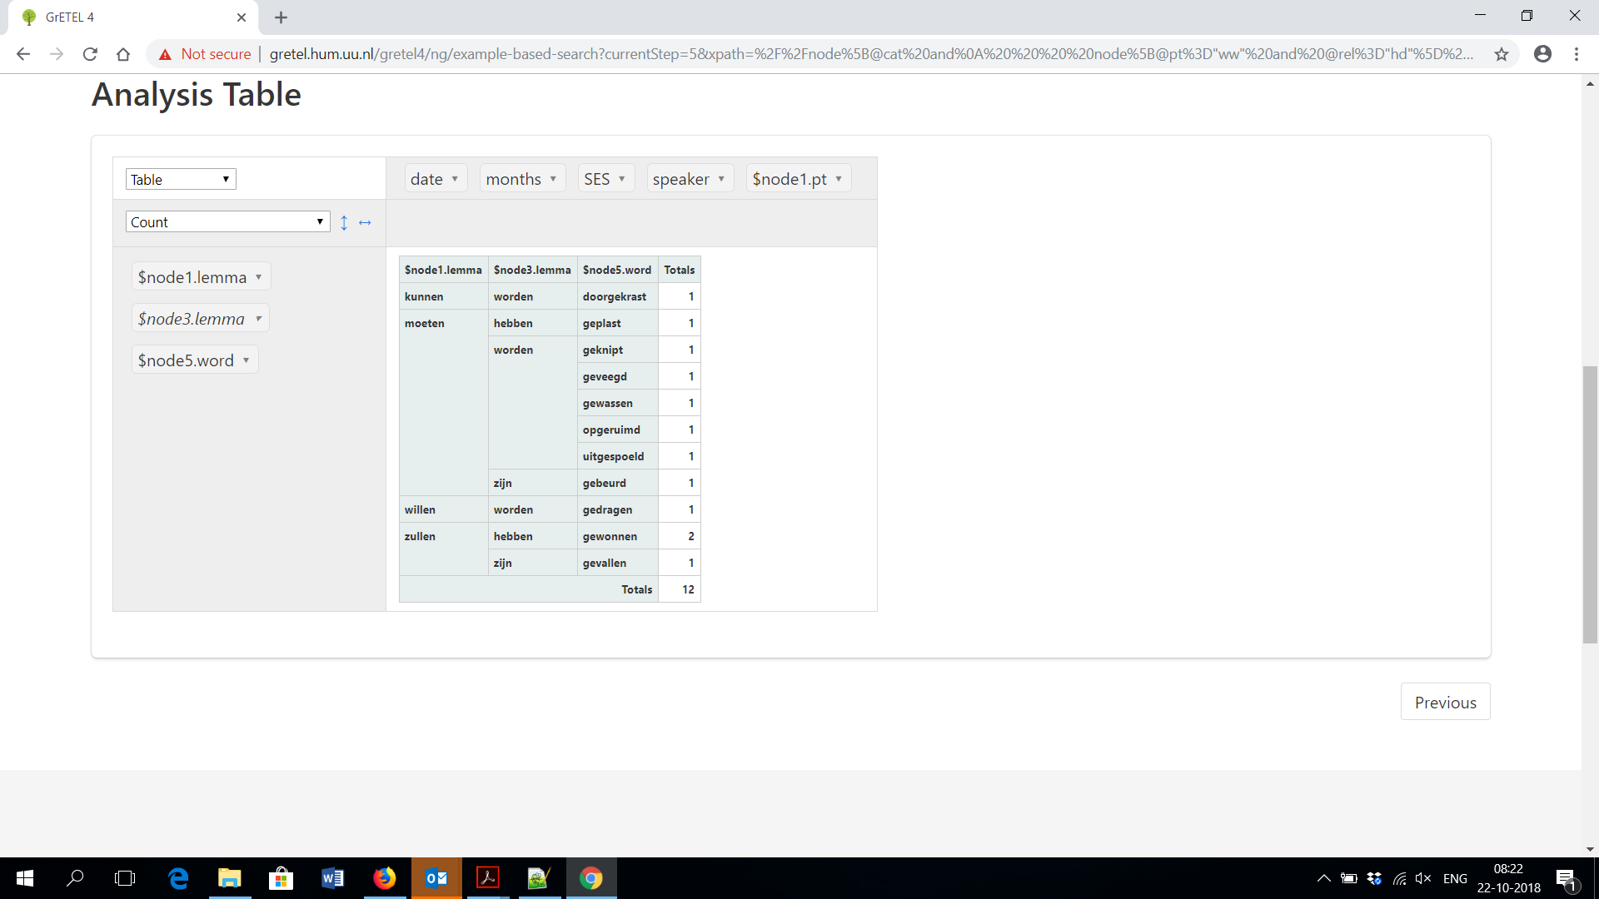
Participles?

Slide 41
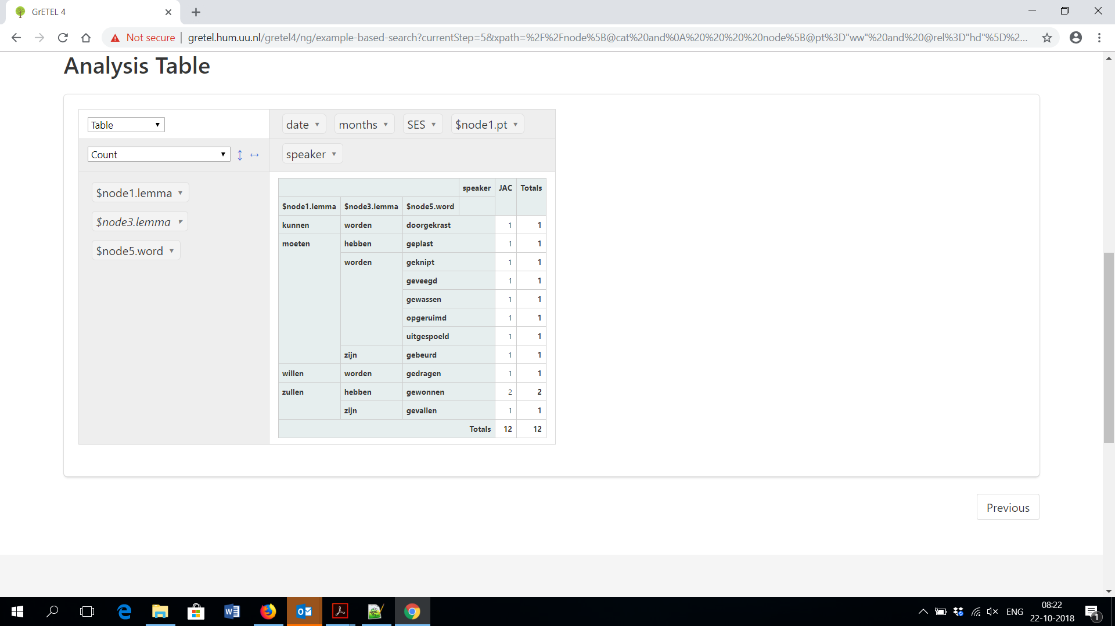
Participles?

Slide 42
Participles?
Results:
  12 (all by JAC)

Slide 43
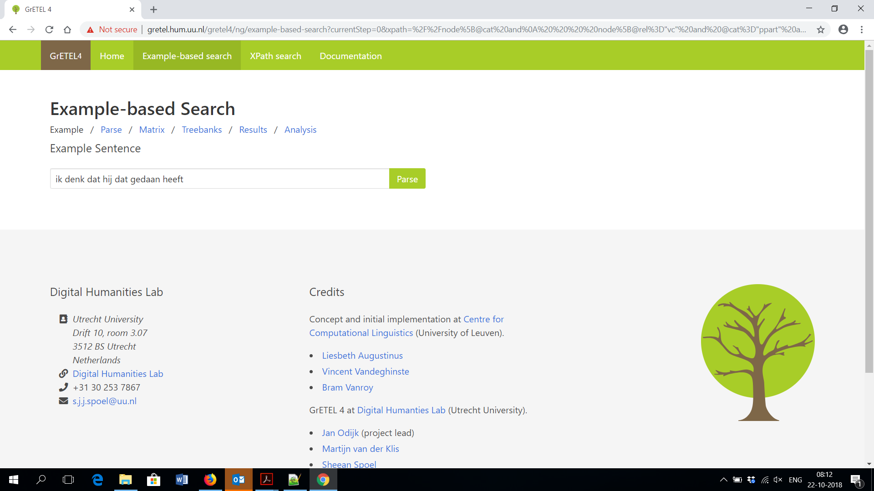
Participles: Green Order

Slide 44
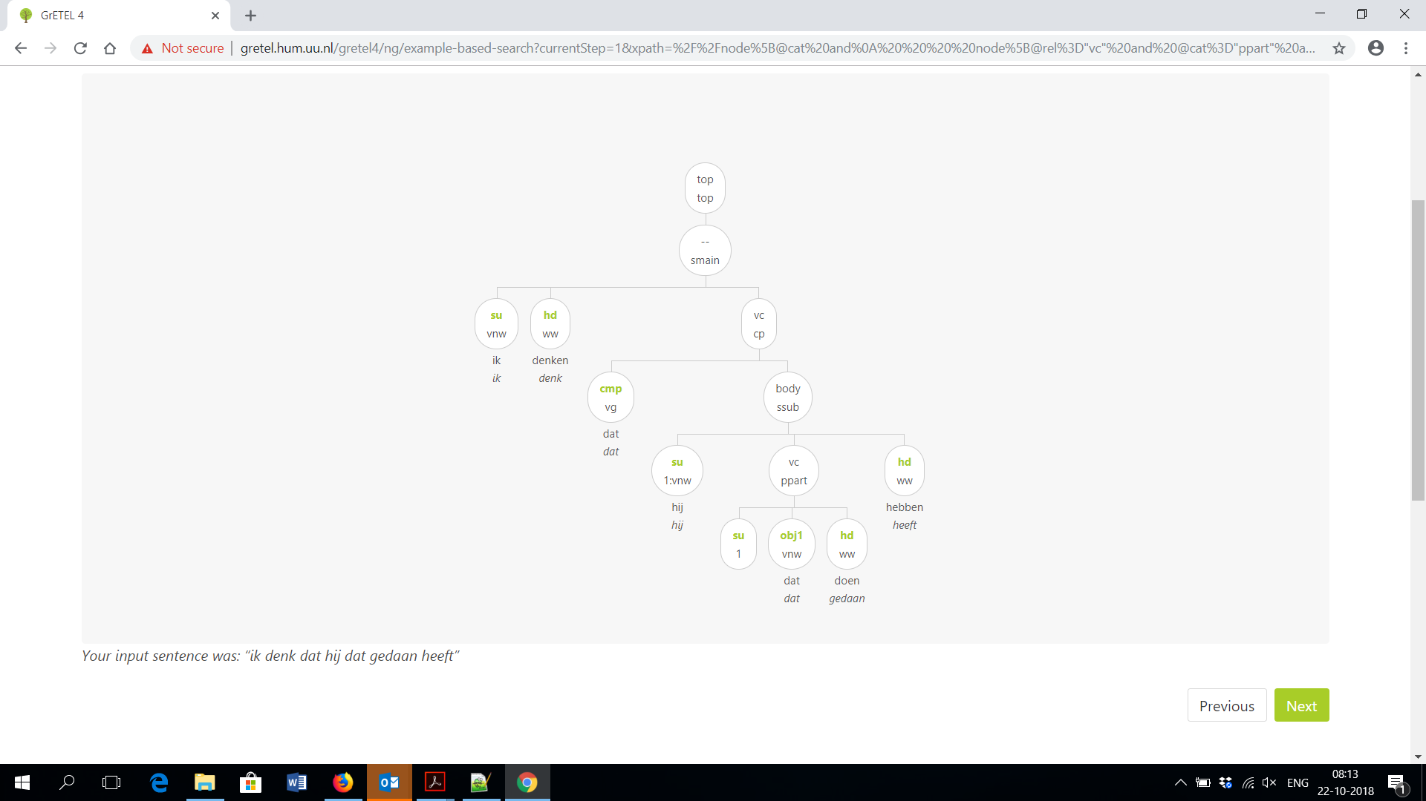
Participles: Green Order

Slide 45
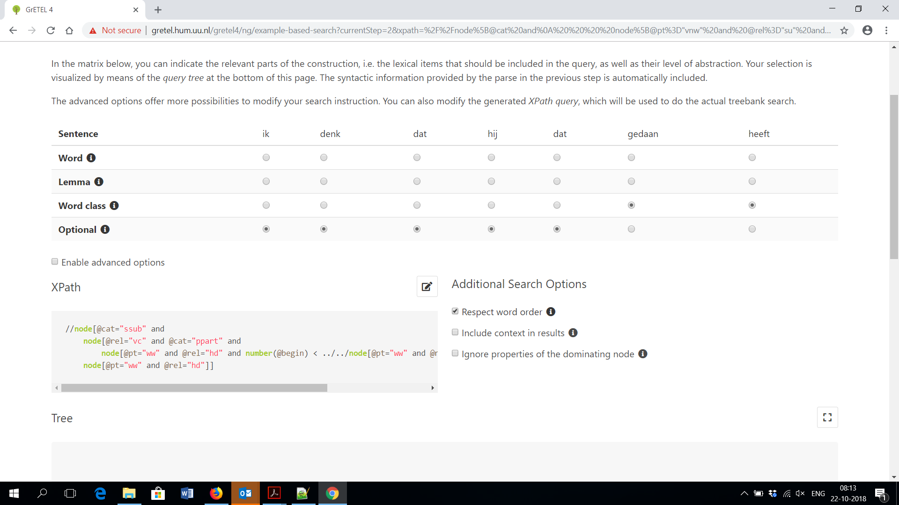
Participles: Green Order

Slide 46

Participles: Green Order

Slide 47
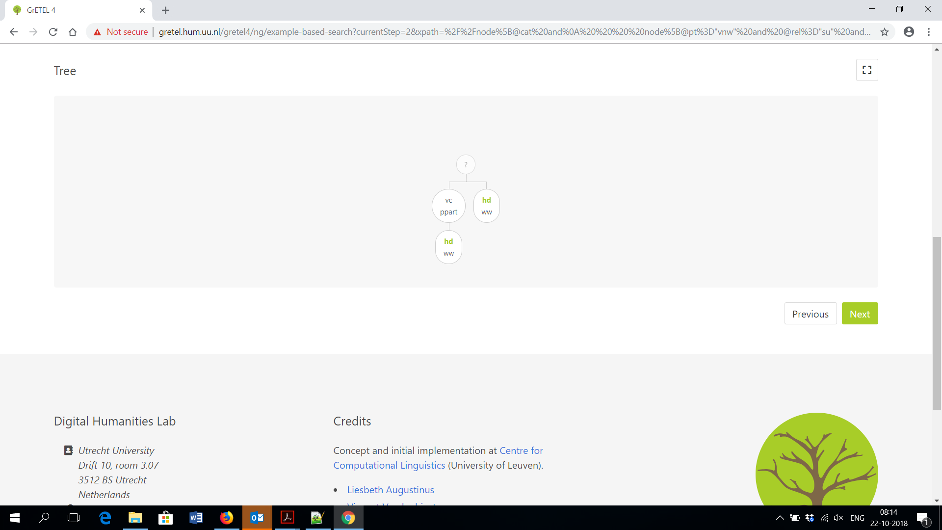
Participles: Green Order

Slide 48
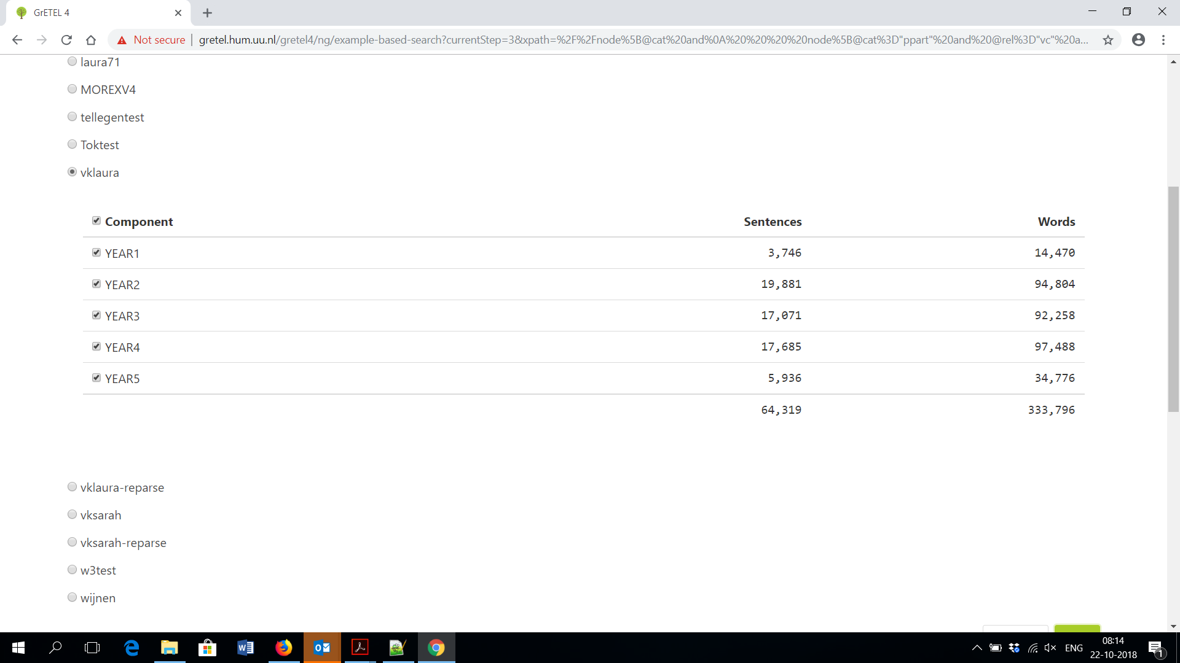
Participles: Green Order

Slide 49
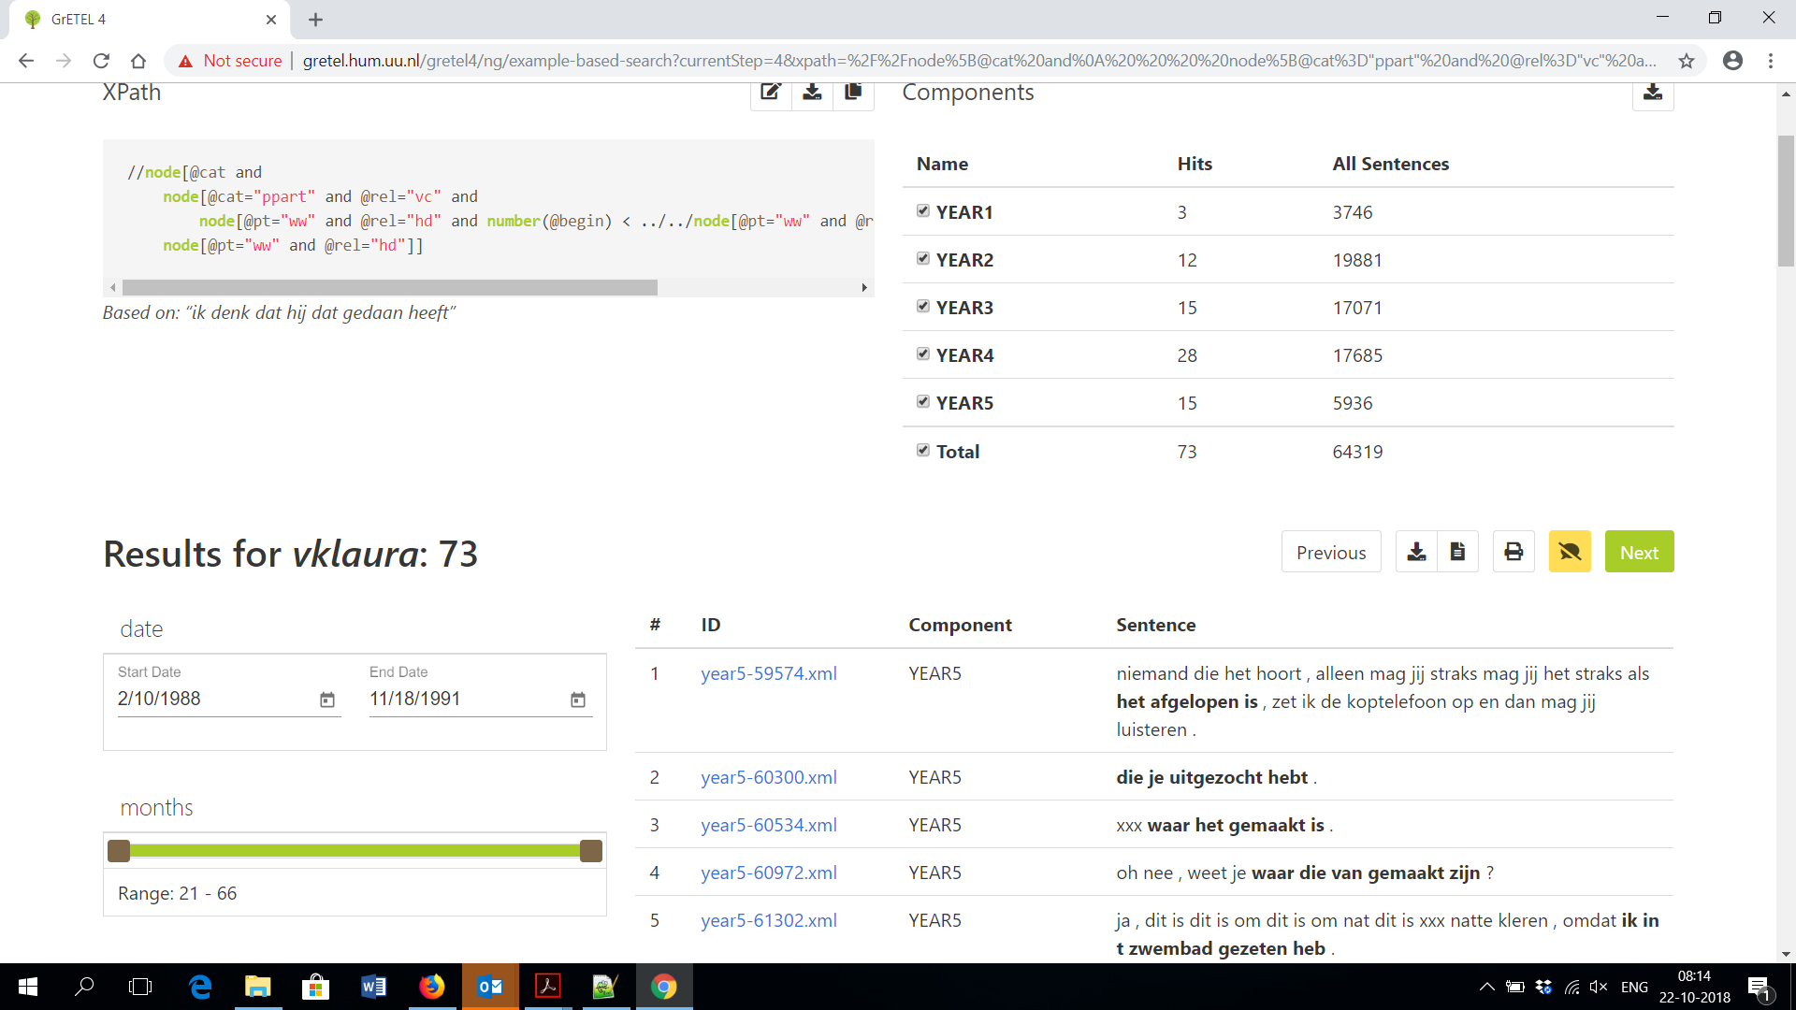
Participles: Green Order

Slide 50
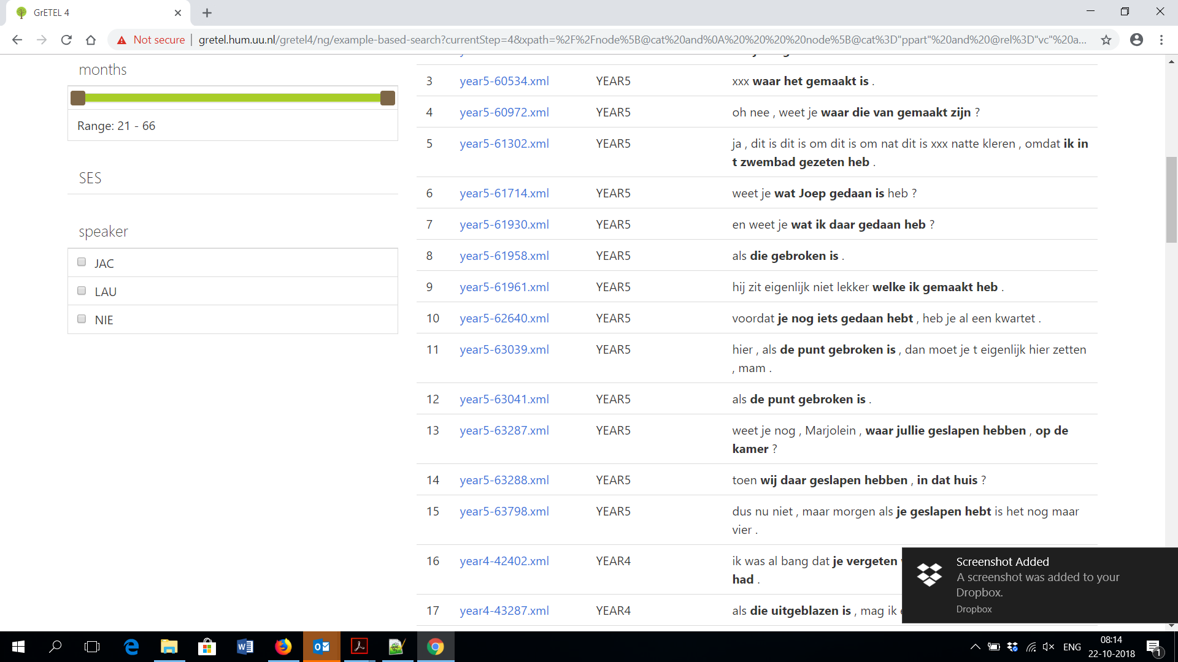
Participles: Green Order

Slide 51
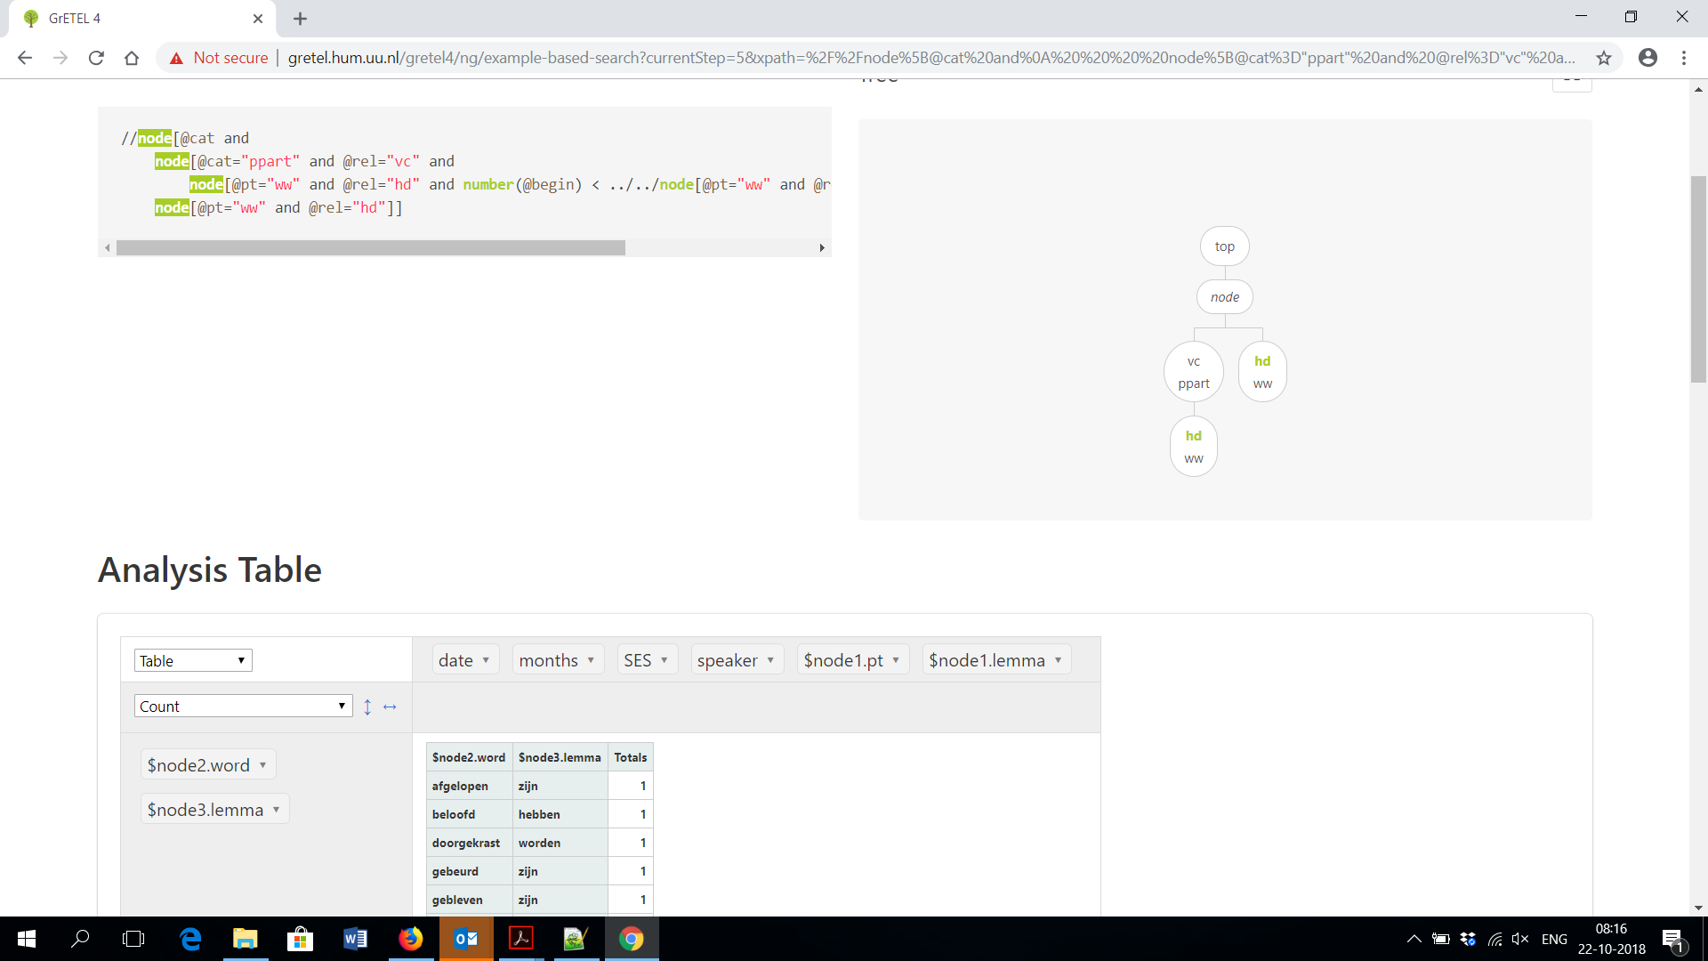
Participles: Green Order

Slide 52
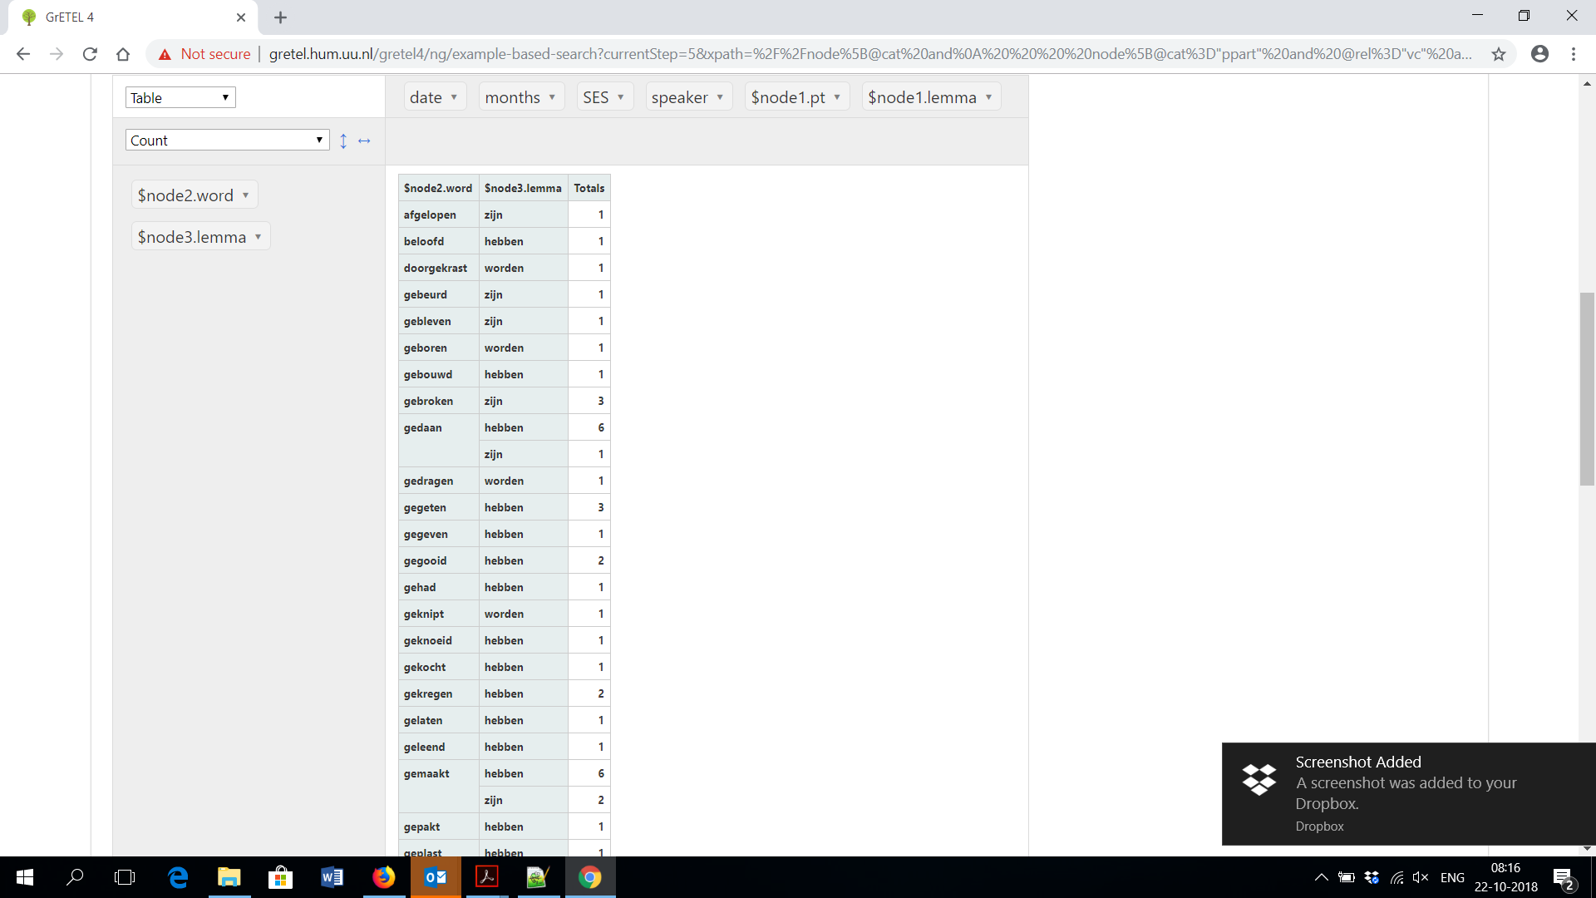
Participles: Green Order

Slide 53
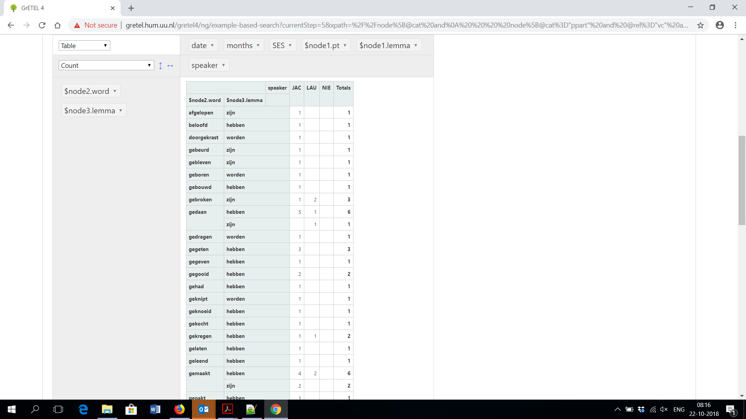
Participles: Green Order

Slide 54
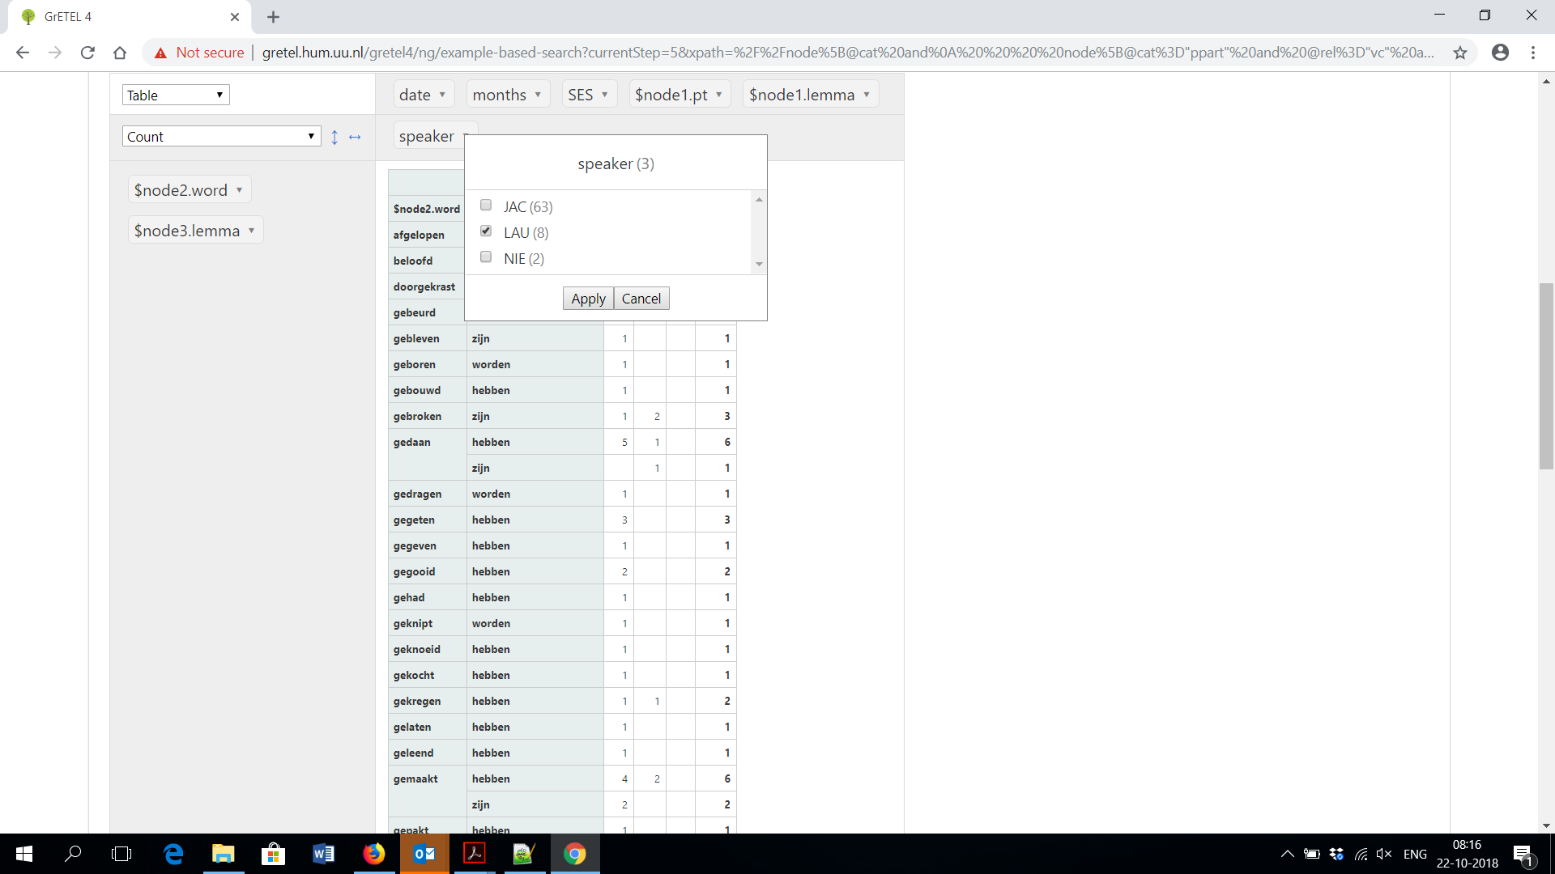
Participles: Green Order

Slide 55
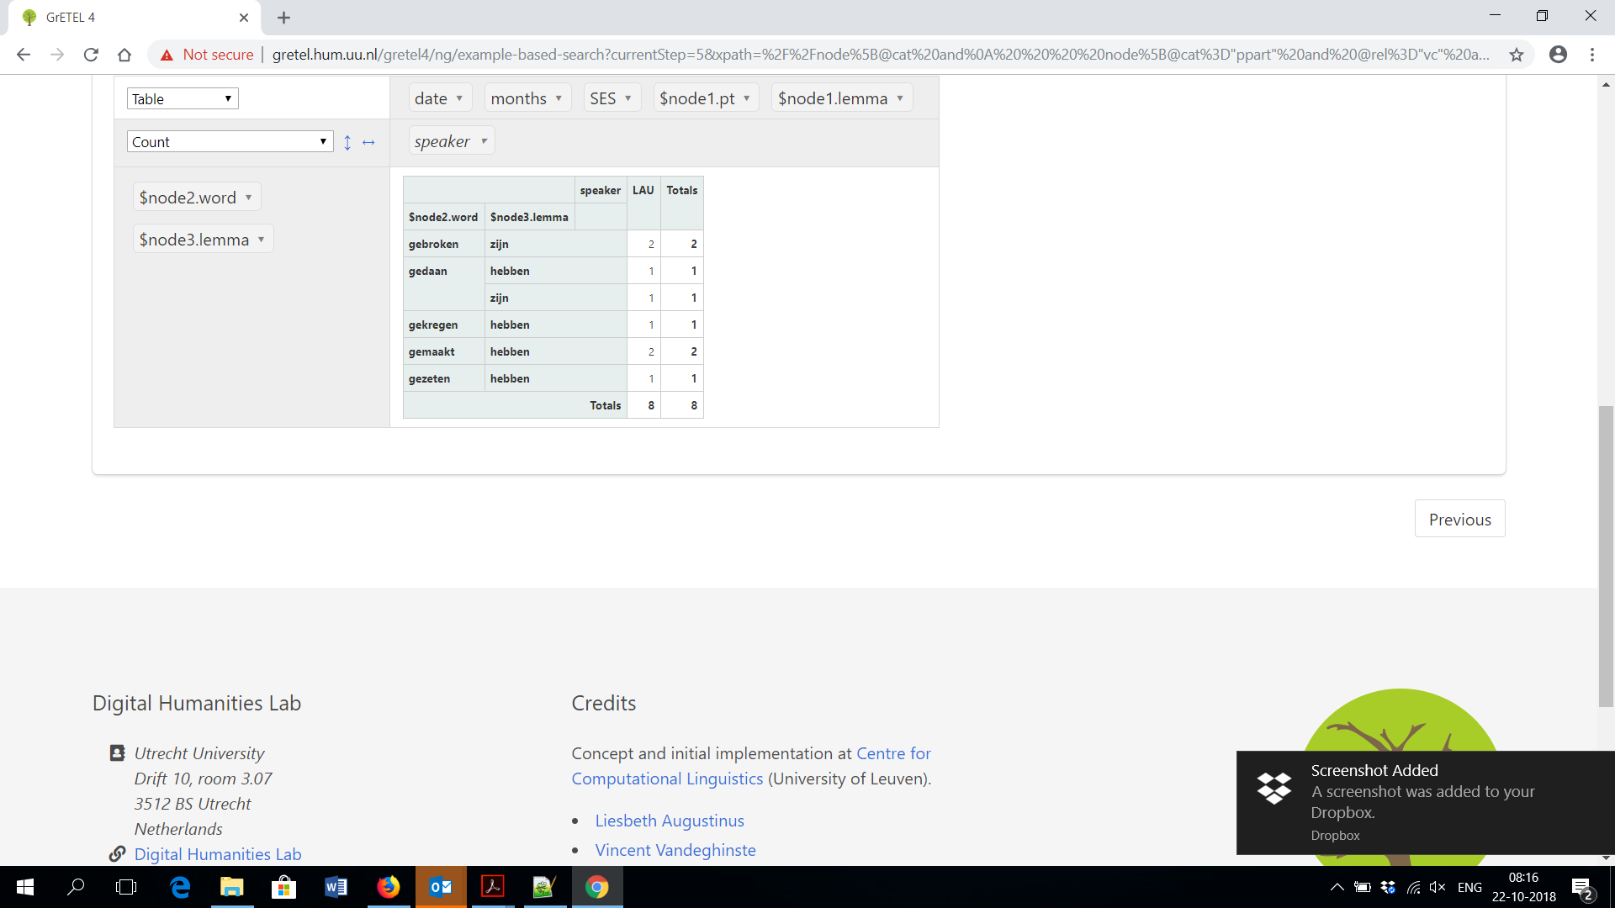
Participles: Green Order

Slide 56
Participles: Green Order
Results:
  Green Order (gekocht heeft): 73
    JAC 63, LAU 8, NIE 2

Slide 57
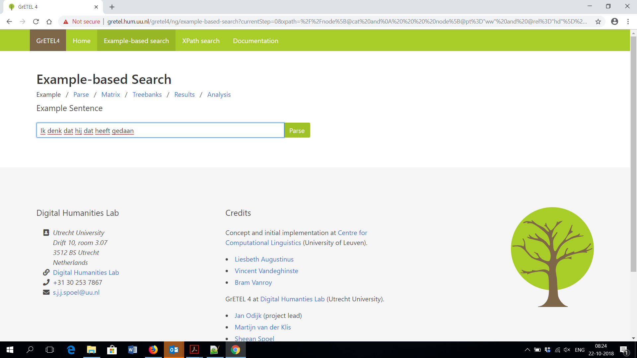
Participles: red Order

Slide 58
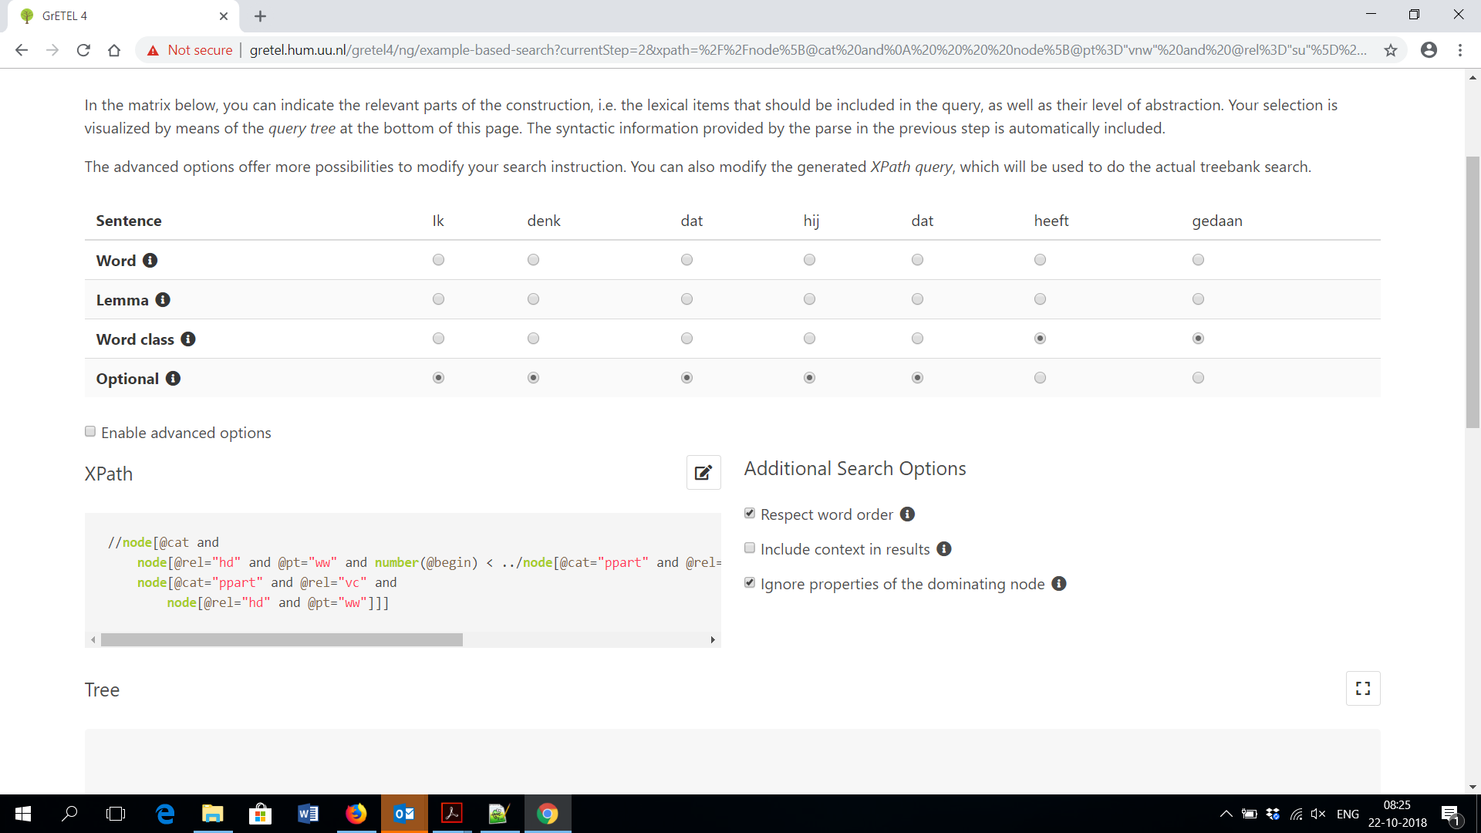
Participles: red Order

Slide 59
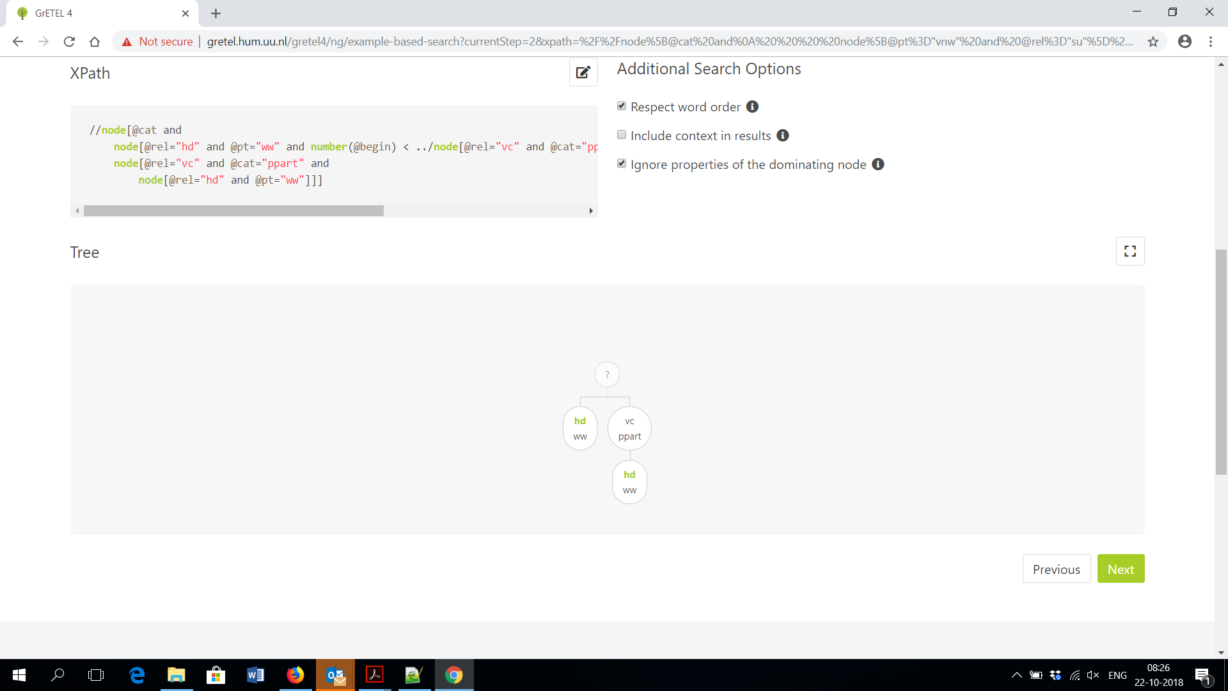
Participles: red Order

Slide 60
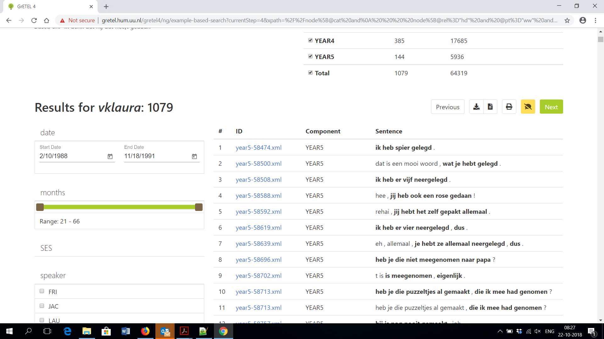
Participles: red Order

Slide 61
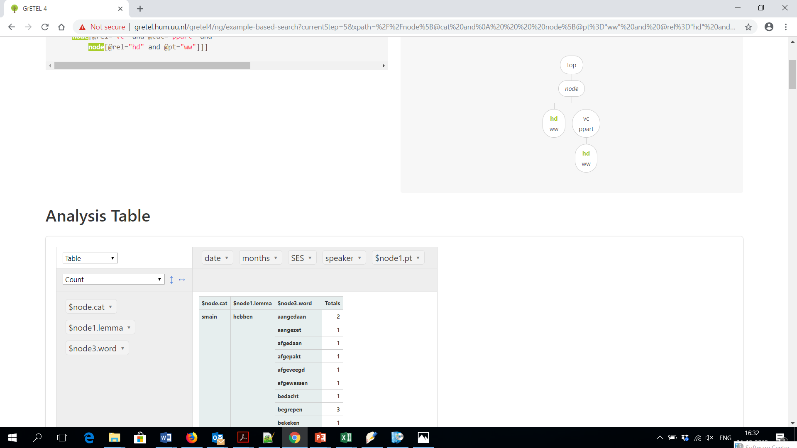
red Order: Analysis Option

Slide 62
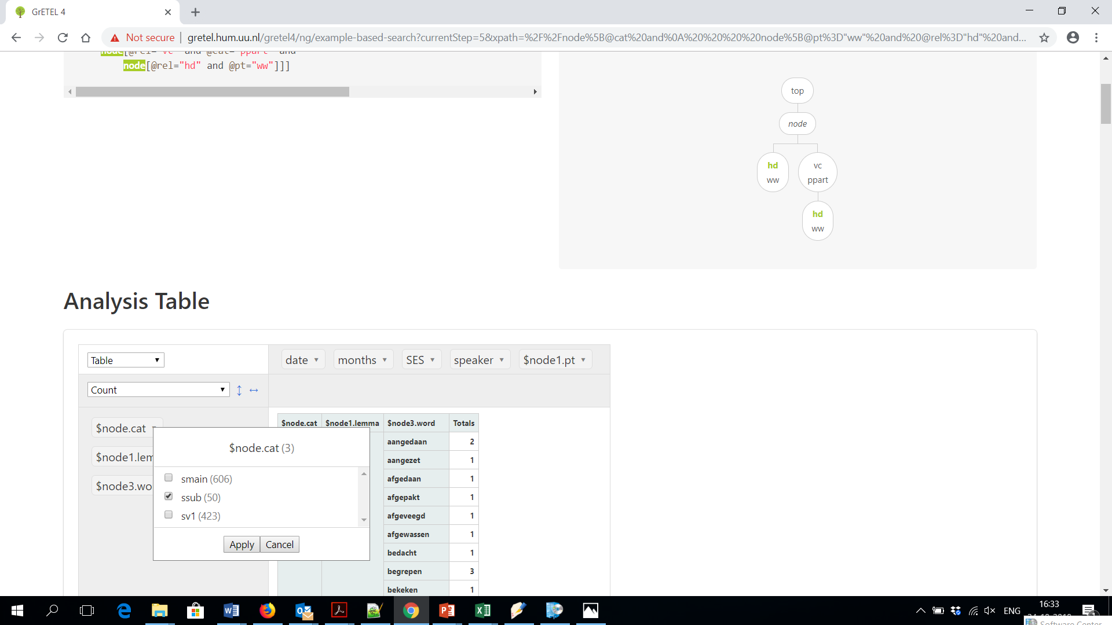
red Order: Analysis Option

Slide 63
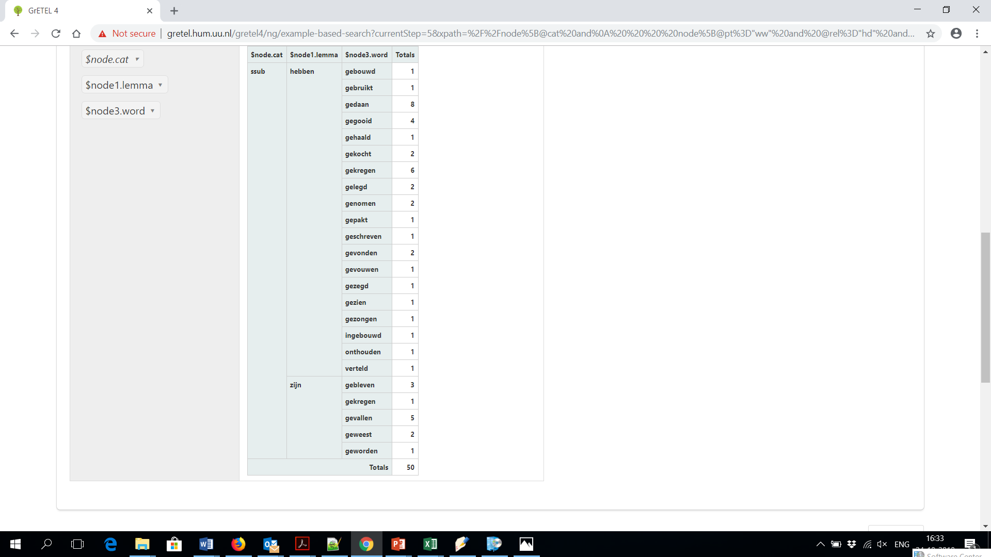
red Order: Analysis Option

Slide 64
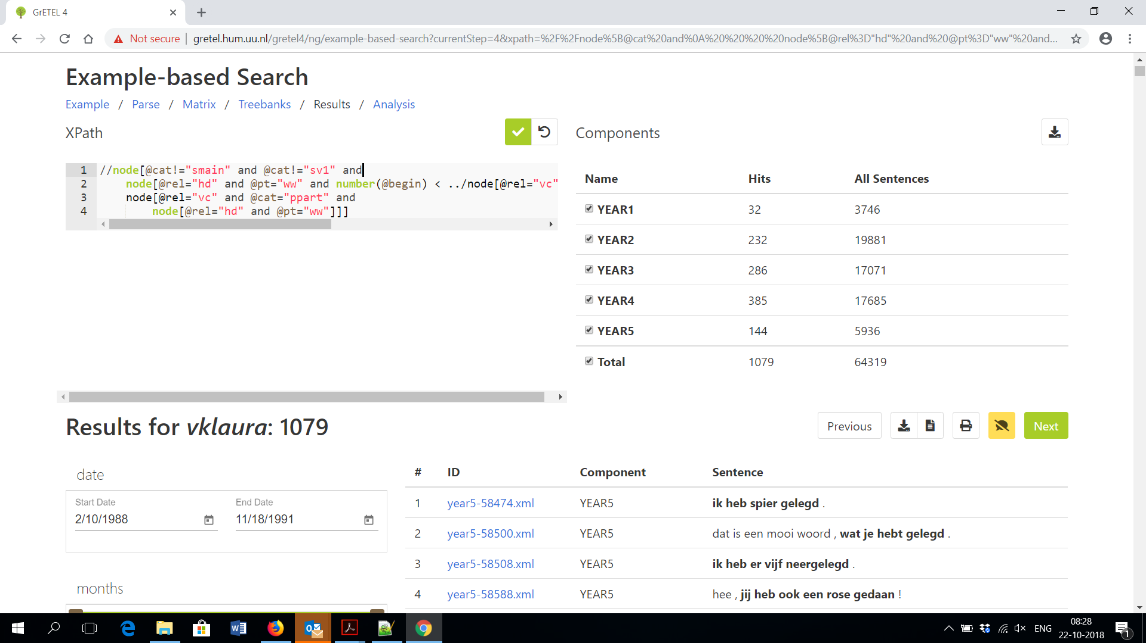
red Order: Edit Xpath Option

Slide 65
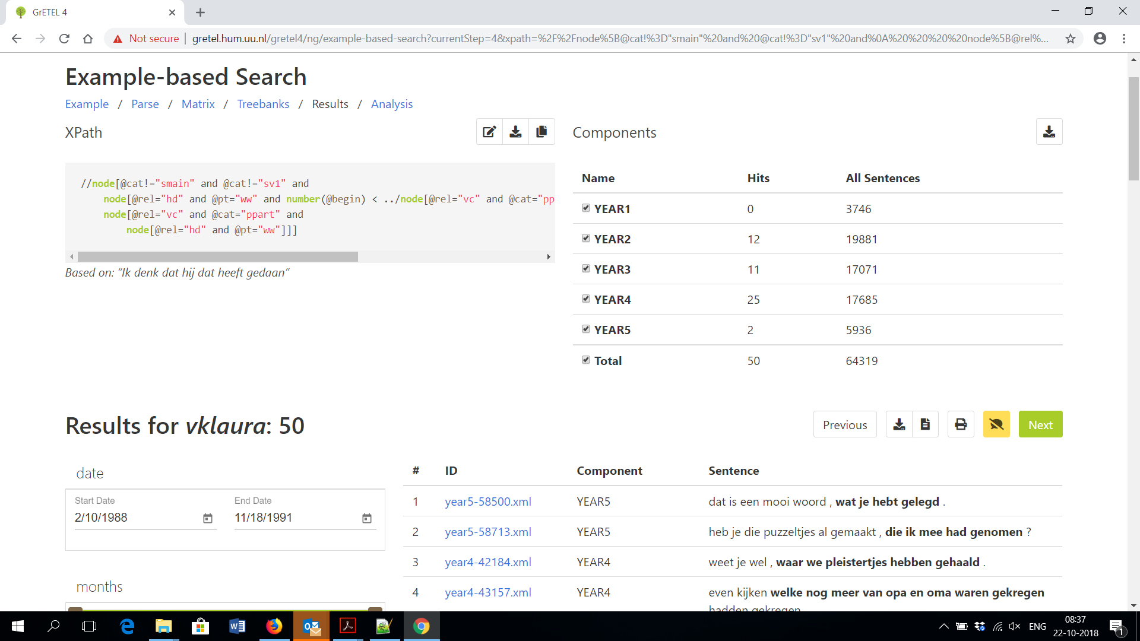
Participles: red Order

Slide 66
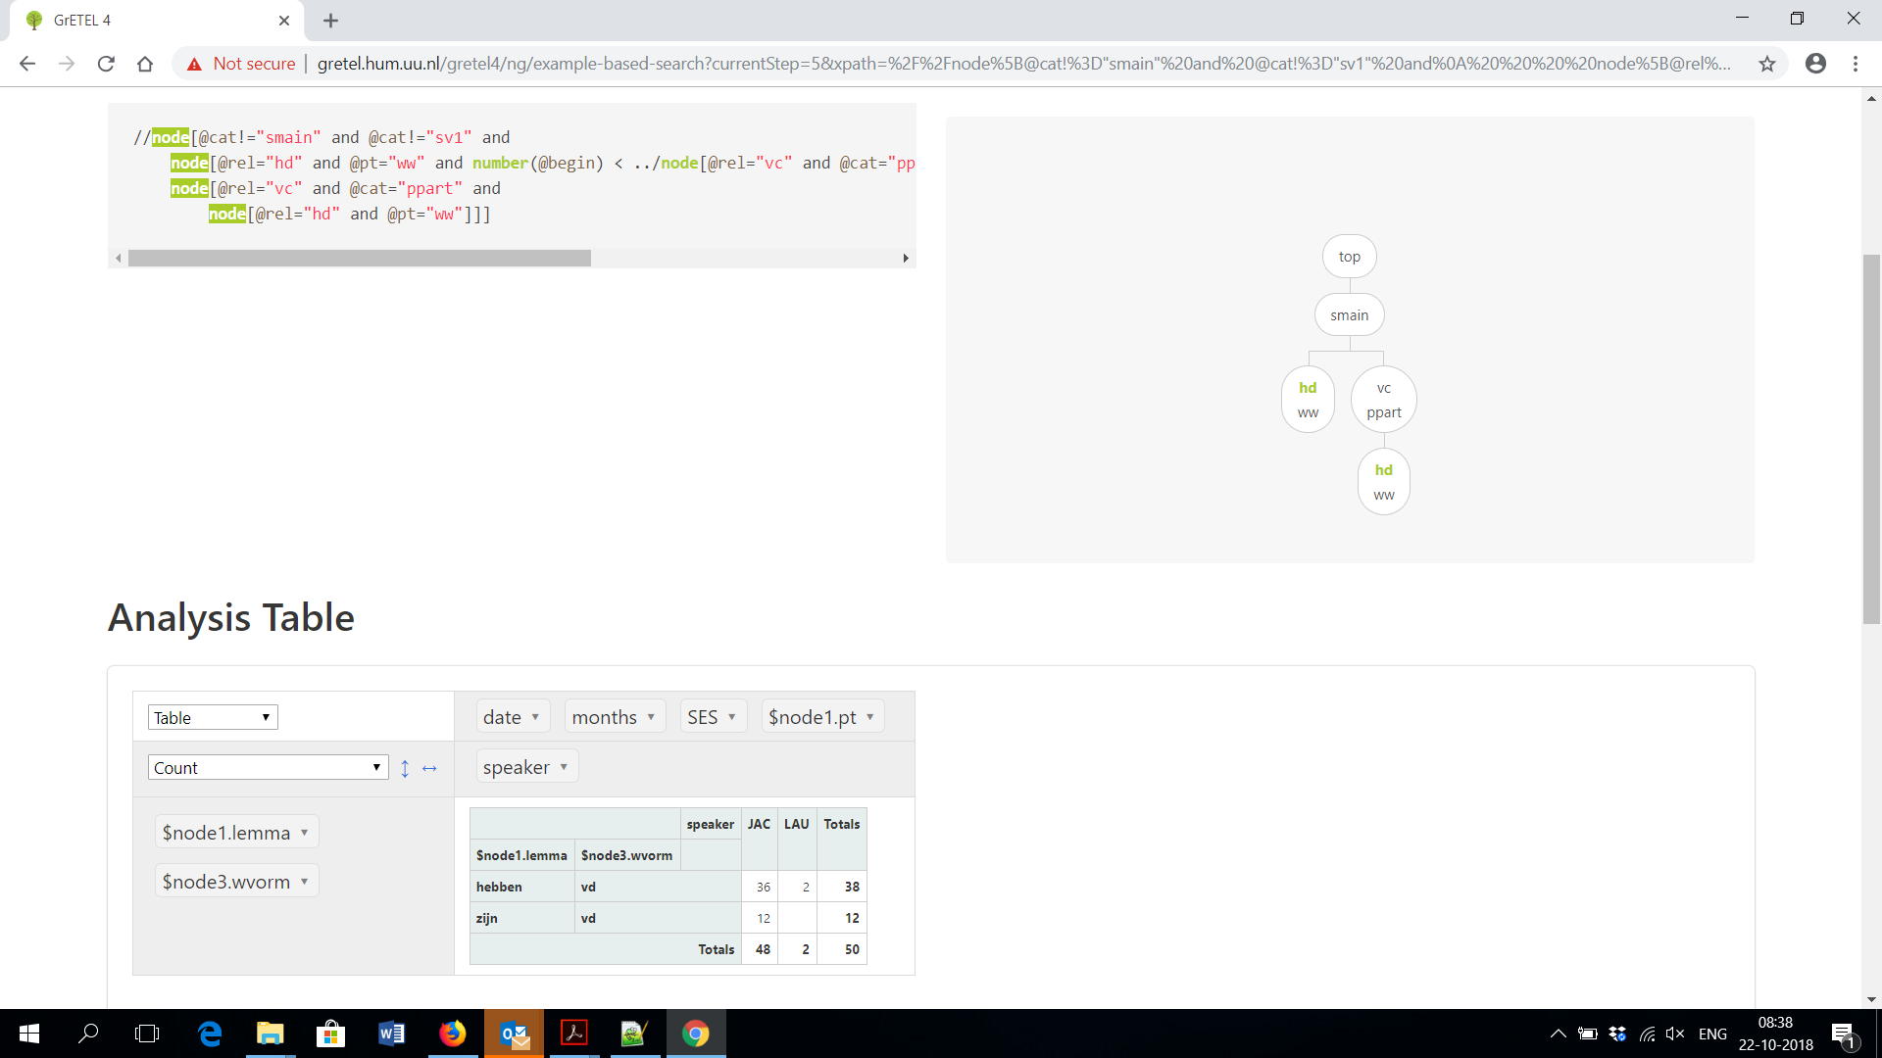
Participles: red Order

Slide 67
Participles: red Order
Results:
  Red Order (heeft gekocht): 50
    JAC 48, LAU 2

